Slide 1
Roadmap for the Next Two Weeks
15. T Mar 17: 4.4. Convergence and Its Absence
Read Before: J. Bradford DeLong (1986): Productivity Growth, Convergence, and Welfare: Comment <https://github.com/braddelong/public-files/blob/master/delong-baumol.pdf>
Read Before: Dev Patel, Justin Sandefur, and Arvind Subramanian (2019): Everything You Know about Cross-Country Convergence Is (Now) Wrong <https://www.piie.com/blogs/realtime-economic-issues-watch/everything-you-know-about-cross-country-convergence-now-wrong>
Slides: <https://github.com/braddelong/public-files/blob/master/econ-135-lecture-15.pptx>
Start: Assignment 7 (6 pts): <https://bcourses.berkeley.edu/courses/1487685/assignments/8082488> Tell Us What Is Happening to You, and What You Wish For; due Mar 20
16. Th Mar 19: 4.5. Inequality and Plutocracy
Slides: <https://github.com/braddelong/public-files/blob/master/econ-135-lecture-16.pptx>
Finish: Assignment 7 (6 pts): <https://bcourses.berkeley.edu/courses/1487685/assignments/8082488> Tell Us What Is Happening to You, and What You Wish For; due Mar 20
Start: Assignment 8: character of modern economic growth paper; due Mar 25
17. Tu Mar 31: 4.6. The Development of Underdevelopment
Read After: W. Arthur Lewis (1978): Evolution of the International Economic Order <https://delong.typepad.com/sdj/2008/04/w-arthur-lewis.html>
Slides: <https://github.com/braddelong/public-files/blob/master/econ-135-lecture-17.pptx>
Finish: Assignment 8: post-1500 growth accelerations paper; due Apr 1
Start: Assignment 9: character of modern economic growth paper; due Apr 8
18. Th Apr 2: Touring the Continents: 5.1. Western Europe, North America, and South America
Read Before: Joel Mokyr (1990): Lever of Riches, chapter 10 Britain and Europe <https://delong.typepad.com/files/mokyr-lever-europe.pdf>
Read Before: John Coatsworth (2008).: Inequality, Institutions and Economic Growth in Latin America <https://delong.typepad.com/files/coatsworth-institutions.pdf>
Slides: <https://github.com/braddelong/public-files/blob/master/econ-135-lecture-18.pptx>

Slide 2
Coronavirus!
With 31 deaths in the U.S. as of March 11, a 1% death rate, and up to 4 weeks between infection and death, that means that as of Feb 12 there were 3100 coronavirus cases in the United States.
With 73 deaths in the U.S. as of Mar 16, a 1% death rate, and up to 4 weeks between infection and death, that means that as of Feb 17 there were 7300 coronavirus cases in the United States
If it is doubling every seven days, then now about 116,000 people have and in the next week about 116,000 more people in the U.S. will catch coronavirus—which means 1/2700, currently 3000 of the 7.6 million inhabitants of San Francisco Bay. Touch a hard surface that any of those 3000 has touched in the last 48 hours, and the virus has a chance to jump to you…
These numbers could be five times too big. These numbers are probably not five times too small unless the thing is a lot less deadly, and there are a lot of asymptomatic cases…
What is wrong with this analysis?

Slide 3

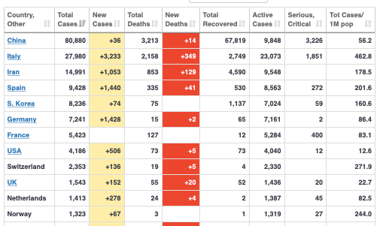
MOAR Coronavirus!
As of March 16: Things are not moving in the right direction:
What is the R0?
How can the R0 be changed?
How will the R0 change?
What is the asymptote share of the population?
What is the mortality rate?

Slide 4

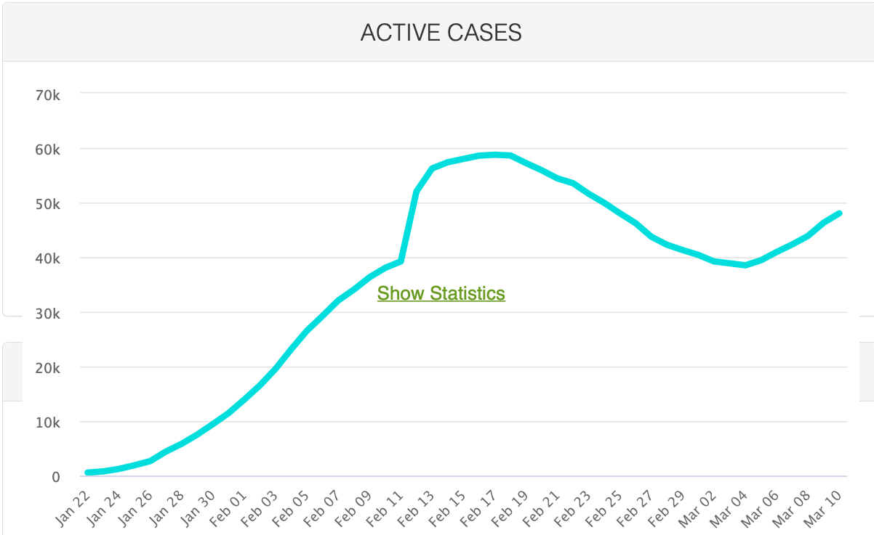
MOAR Coronavirus!
As of March 10: Things are not moving in the right direction:
What is the R0?
How can the R0 be changed?
How will the R0 change?
What is the asymptote share of the population?
What is the mortality rate?

Slide 5
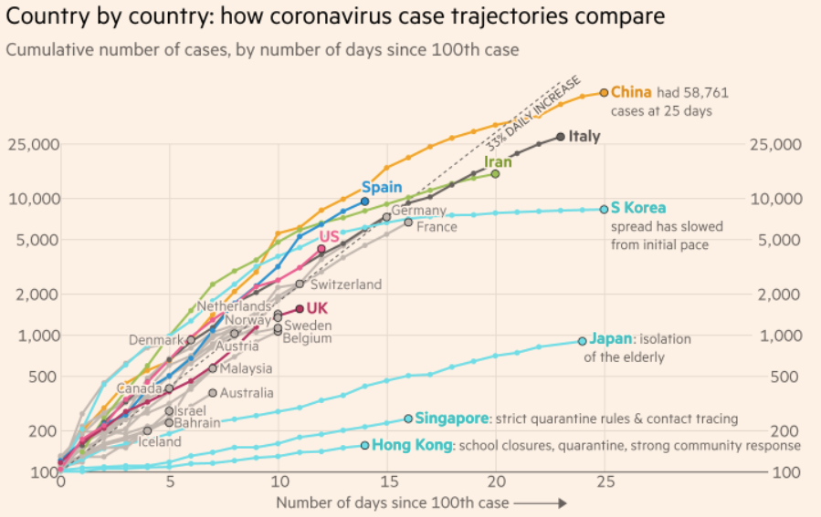
MOAR Coronavirus!
What I am watching:
Max Roser & Hannah Ritchie: Coronavirus Disease (COVID-19)_ <https://ourworldindata.org/coronavirus>…
Worldometer: Coronavirus Update (Live) <https://www.worldometers.info/coronavirus/>: ‘125,599 Cases and 4,605 Deaths from COVID-19 Virus Outbreak…
FT Coronavirus Tracker <https://www.ft.com/content/a26fbf7e-48f8-11ea-aeb3-955839e06441>
<https://www.nytimes.com/interactive/2020/us/coronavirus-us-cases.html>

Slide 6

MOAR Coronavirus!
It’s a Thing for Geezers!
Mortality for the Youngs very low…
It’s the flu for them…

Slide 7
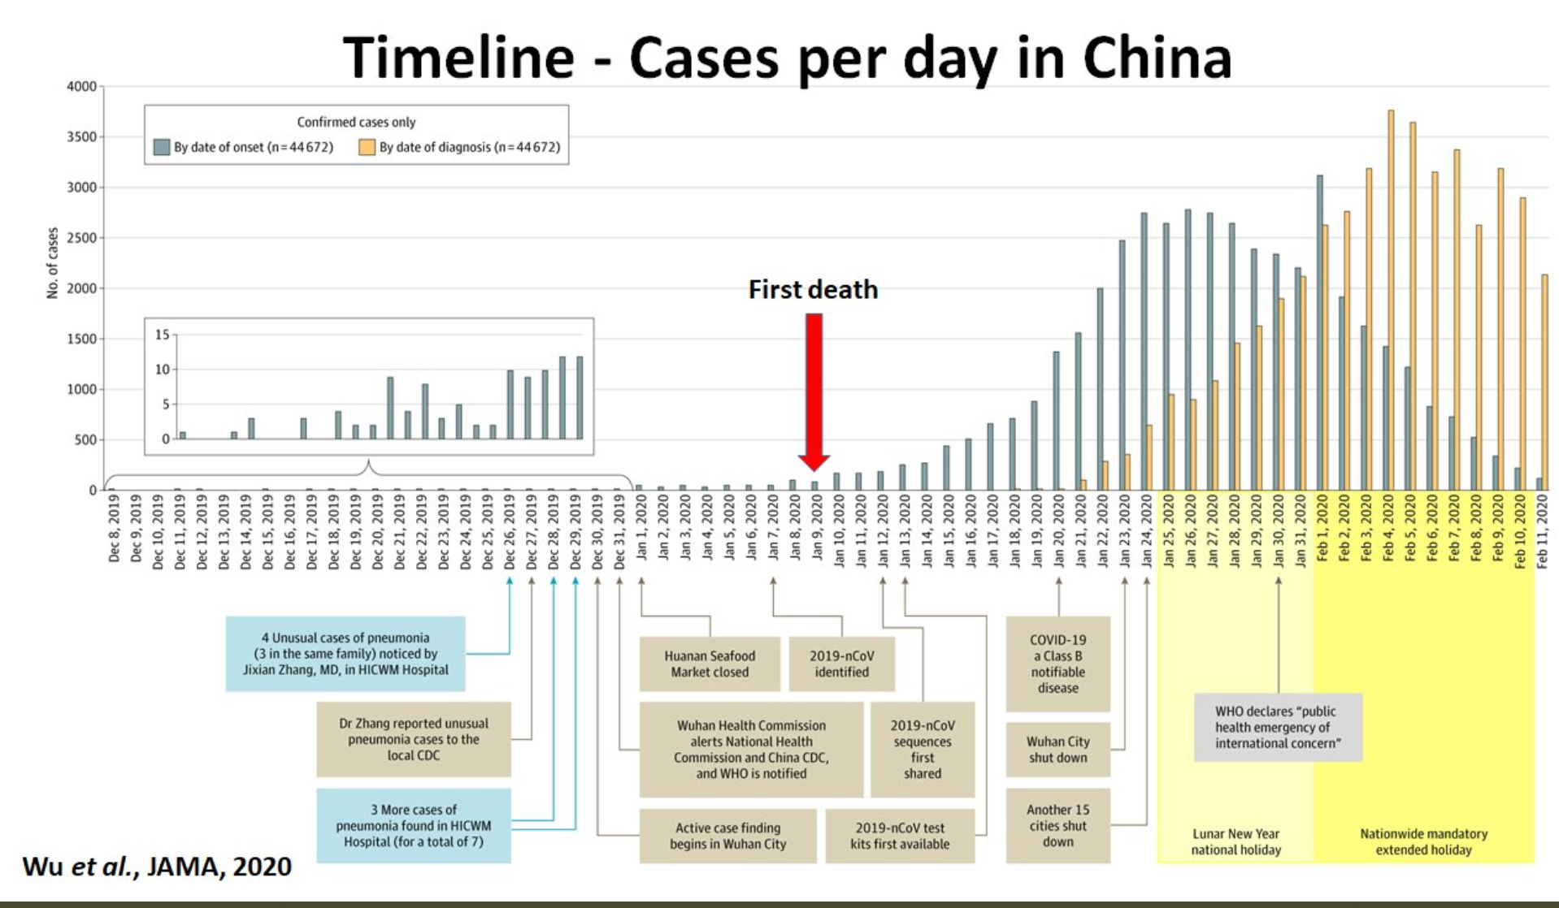
MOAR Coronavirus! II
China Beat It!
Shut down Wuhan when 200 cases per day
That seems to have been a good decision

Slide 8

MOAR Coronavirus! III
When Is It Appropriate to Move on This?
Immediate social distancing…
Self-isolate if you have a cough and a fever…
Hope that warmer temperatures will do to this what they did to SARS…
Otherwise, when do you want to start spreading out transmission. It seems that early is as good as later…

Slide 9
Catch Our Breath…
Ask a couple of questions?
Make a couple of comments?
Any more readings to recommend?

Slide 10
Notes

Slide 11
Lecture 16:
4.5. Inequality and Plutocracy
Brad DeLong
Department of Economics & Blum Center, U.C. Berkeley; & WCEG
last revised: Mo 2020-03-16
for presentation: Th 2020-03-19
Original course by Melissa Dell (Harvard Econ 1342), revised by Brad DeLong
<https://github.com/braddelong/public-files/blob/master/econ-135-lecture-16.pptx>

Slide 12
Big Ideas: Lecture 15: Convergence and Its Absence
Takeaways from last lecture:
Give me five…

Slide 13
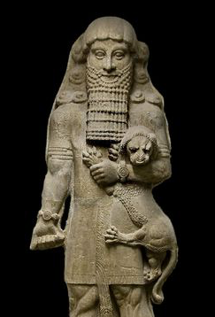

Inequality Has Ruled since Shortly After the Invention of Agriculture
Farming changes the game:
Once you have farms, you have large social groups
Bigger than, say, 100 at most
And you can’t run away…
Thugs with spears—and thugs with time to train…
Grifters with knowledge of the stars (which is, I must admit), useful…
And we were off and running…
1:30
Notes:
Gross, large scale inequality has been with us humans since at least shortly after the invention of agriculture.
Once you have farms, you see, you have the potential for large social groups—much larger than the 100 or so that seems to have been the size of our social groups back in the gatherer-hunter age. And once you have your farm, it becomes much more difficult to run away from unpleasant people.
Therefore, after the invention of agriculture, we get people who make a living as thugs-with-spears. They say: "give me a third of your crop or I will poke you with my spear". And you cannot move away before the harvest. And so they take a third of your crop.
And then, because they do not have to work growing their own crops, they train with their spears, and so become very good expert practitioners of coercive violence.
Then there are the other grifters who watch the stars and can predict the actions of the gods ans nature from their special knowledge. For example, they can tell you when the stars are so aligned that it will be time to start planting after the next full moon. They can tell you that you had better get the harvest in before the next new moon because the stars say that Father Winter is on its way to freeze the crops. And they are right often enough that you are happy to pay them a sixth of your crop.
Thus we were off and running: toward unequal, hierarchal societies...

Slide 14
Inequality Has Ruled: Ideological Legitimation
Gilgamesh in his element:
“Around the enclosed space that is Uruk he walks, mighty like the wild bull, head raised high. None with weapon might challenge him as rival. His men stand at attention, longing for his orders; but the old men of Uruk grouse that Gilgamesh has left no son to his father, for his arrogance has grown boundless…
William Muss-Arnolt, trans.: The Man Who Has Seen All Things <http://www.jasoncolavito.com/epic-of-gilgamesh.html>
2:00
Notes:
What happens when one thug with a spear meets another thug with a spear? It can get ugly. So sooner or later the thugs with spears organize themselves, with marked out and assigned territories. It still gets ugly among them. But it gets ugly less often. However, when it does get ugly it can get very ugly indeed: we have what we now call the social practice of "war".
Moreover, within the group of these expert practitioners of coercive violence—plus those who predict the actions of nature and the gods by watching the stars—there arises a problem: how they are going to distribute the crops that they have taken from the farmers at the point of the spear? Internal hierarchy develops among the elite. And, perhaps around the year -3000, these internal hierarchies begin coming to a very sharp point at the top.
The oldest thing that has survived and come down to us that can be called a story or a piece of literature is the ancient Mesopotamian document: _The Man Who Has Seen All Things_, what we call the _Epic of Gilgamesh_. Its protagonist is, well, Gilgamesh, portrayed holding a lion cub in the statue on the right. The epic describes Gilgamesh in his setting: king of the city of Uruk, in Mesopotamia. The statue shows how at least later generations remembered Gilgamesh's physique: buff, swoll, mighty-thewed, and does his face look wise, and perhaps even fair? The lion cub looks remarkably placid—perhaps drugged, or perhaps acknowledging that Gilgamesh is even lord of lions. Listen to the description:
>Around the enclosed space that is Uruk he walks, mighty like the wild bull, head raised high. None with weapon might challenge him as rival. His men stand at attention, longing for his orders; but the old men of Uruk grouse that Gilgamesh has left no son to his father, for his arrogance has grown boundless…

Slide 15
Authoritarian and Sexual Tyrant
Gilgamesh, in his element, continued:
“He has taken all their children, for is Gilgamesh not the shepherd of his people?
“Gilgamesh does not leave a daughter to her mother, nor the maiden to the warrior, nor the wife to her husband.
“Yet Gilgamesh is the magnificent and glorious shepherd of his people.
“The gods heard the people’s cry, and the gods of heaven beseeched the Lord of Uruk, Anu the god…”
3:15

Slide 16
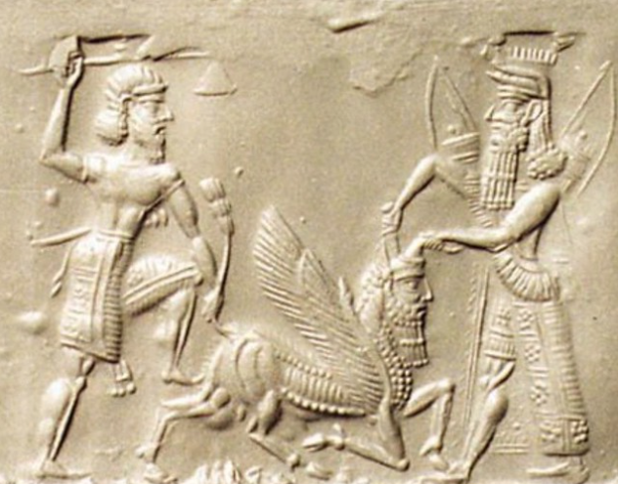
The First Male Bonding Buddy Story
The gods do respond:
The cries of the people of Uruk lead the gods to do something…
But the gods do not reform the institutions of the polity of Uruk…
Instead, they create a buddy for Gilgamesh: Enkidu
Gilgamesh and Enkidu fight, and then they bond, and then they become best friends, and then they have adventures and go on quests
By the end of the story Enkidu has died, the serpent has taken something immensely valuable away from humanity, and Gilgamesh has experienced personal growth: he is a much wiser—and much better—king
But he remains king: Uruk remains a polity of gross inequality
Gilgamesh and Enkidu slaying the Bull of Heaven
Neo-Assyrian, -800 ro -600
<www.bibleorigins.net/illustrationofGilgameshAndEnkidu.html>
1:15
Notes:
What the gods do is that they improve the lot of the people in Uruk by distracting Gilgamesh. They give him other things to do, so that he will leave the people of Uruk alone and not oppress them. They set in motion the first male-bonding buddy story.
What the gods do in response to the cries of the people of Uruk for them to do something is not to reform the institutions of the polity of Uruk or to smack Gilgamesh down. Instead, they create a buddy for Gilgamesh: Enkidu. Gilgamesh and Enkidu fight, and then they bond, and then they become best friends, and then they have adventures and go on quests
By the end of the story Enkidu has died, Gilgamesh has learned about how humanity survived the great worldwide flood, a barmaid has given him lessons in Epicurean philosophy, the serpent has taken something immensely valuable away from humanity, and Gilgamesh has experienced personal growth: he is a much wiser—and much better—king.
Read it. It is a great story.
But Gilgamesh remains king: Uruk remains a polity of gross inequality.

Slide 17
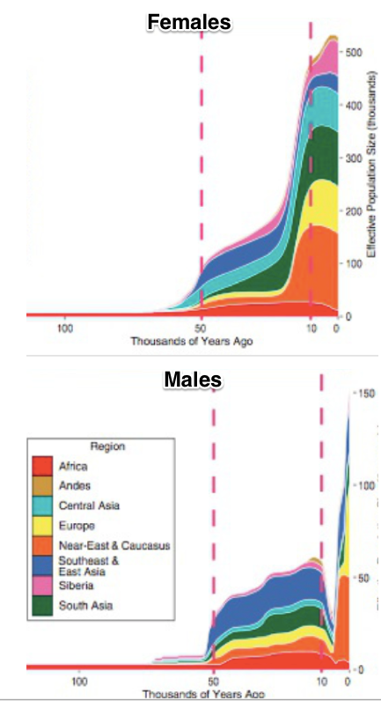
Inequality and Patriarchy
Agrarian age inequality is inscribed in our genes:
Everyone inherits their mitochondria from their mothers
Every male inherits his Y-chromosome from his father
From -5000 to -2000, a huge chunk of Y-chromosome lineages are not propagating
Polygyny for some—and non-matrimony for others
Persistence of (male) descent groups
What’s life like for women as this goes on?
https://logarithmichistory.wordpress.com/2015/09/27/the-patriarchal-age/
http://genome.cshlp.org/content/early/2015/03/13/gr.186684.114.full.pdf
4:00
Notes:
There is a very close and intimate connection in the agrarian age between gross inequality and high patriarchy. Agrarian age inequality is literally inscribed in our genes.
It is an elementary fact of our genetics that there is a small proportion of our genome—the mitochondrial DNA genome—that we inherit only from our mothers. Thus we can trace descent back through the exclusively female line, and by looking at the amount of mutations and genetic divergence in a human population today in that portion of the genome, determine the effective female population size of the human race back in the past all the way back to mitochondrial Eve: the woman who is the mother's mother's mother's... mother's mother's mother of us all.
And It is an elementary fact of our genetics that there is a small proportion of every male's genome—the y-chromosome genome—that we inherit only from our fathers. Thus we can trace descent of males back through the exclusively male line, and by looking at the amount of mutations and genetic divergence in a human population today in that portion of the genome, determine the effective male population size of the human race back in the past all the way back to y-chromosome Adam: the father who is our father's father's father's... father's father's father of us all.
When we do this, we find something going on between the years -5000 and -2000 according to our calendar: the effective female population size becomes much much much much larger than the effective male population size, and then they resume the rough equality that they had had before the year -5000 and since the year -2000. But in between, well, the overwhelming bulk of women are having daughters who have daughters... whose daughters' daughters' daughters are among us. A smaller percentage of men are. Only a small proportion of men breed, and then their sons breed and their sons breed, so that the chain is such that their sons'... son's sons are among us.
This is polygyny: one man, many wives—and lots of men with no wives and little sexual access to women. This is the Biblical Patriarch Jacob: 13 children with two wives and two concubines. Jacob and Leah's children were Reuben, Simeon, Levi, Judah Issachar, Zebulun, and Dina; Jacob and Rachel's children were Joseph and Benjamin; Jacob and Zilpah's children were Gad and Asher, and Jacob and Bilhah's children were Dan and Naphtali. And somewhere in the neighborhood there were three men—unnamed—who were without wives, and without children. Leah, Rachel, Zilpah, and Bilhah's mitochondrial DNA lineages were passed down. The three nameless men's y-chromosome lineages were not: only Jacob's was.
Maintaining polygyny for a number of generations requires great social pressure and great societal inequality among men. It also requires a great deal of subservience among women. Back in the age -5000 to -2000, women were, to a substantial degree, property: the property of their fathers, and then of those in the patriarchal polygynous network who gained control over them. And back in the age -5000 to -2000, a great many men were without resources‚ for the overwhelming majority of men would, if they had resources to deploy to attain any form of social power, would have chosen to use those resources to marry. And yet many of them could not do so
What was human life and human inequality like back in this patriarchal age? What brought it on? What made it come to an end?

Slide 18
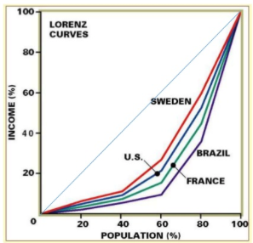
What Is the Gini Coefficient?
A number describing inequality—that I at least find hard to understand what it means:
Here are some facts to give you some intuition:
If the bottom 3/4 got 1/4 of the income and the top 1/4 the rest (evenly distributed), the Gini would be 0.5
If the bottom 2/3 got 1/3 of the income and the top 1/3 the rest (evenly distributed), the Gini would be 0.33
The Gini is income: not status. The 4M slaves in the U.S. in 1860 would have objected most strongly to claim that U.S. then no more unequal than Britain
If you were to think like a utilitarian—and assume that each doubling of income is equally valuable in a utilitarian sense—a move from a Gini of 0.5 to 0.33 would be like a 30% boost to everyone’s income
1:50
Notes:
A parenthesis: when you listen to a discussion of inequality, you may hear lots of references to something called the "Gini Coefficient". What is this Gini Coefficient?
It is a number describing and summarizing a society's inequality —a number that I find I have a very hard time grasping, a hard time understanding what saying "this society's Gini is X" really means. It is not intuitive to me.
Here are some facts to give you some intuition:
1. If the bottom 3/4 of a population got 1/4 of the income and the top 1/4 got the rest, and if income were evenly distributed within the bottom 3/4 and within the top 1/4, the Gini coefficient would be 0.5.
2. If the bottom 2/3 got 1/3 of the income and the top 1/3 got the rest, and if it were evenly distributed within the bottom 2/3 and within the top 1/3, the Gini would be 0.33.
The Gini is income, not status or power: the 4 million slaves in the United States in 1860 would have objected most strongly to claims that the United States was then no more unequal than Britain. Yet that is what the Gini coefficient calculated from the income distribution shows.
If you were to think like utilitarian, and assume that each doubling of income is equally valuable in a utilitarian sense, then a move from a Gini of 0.5 to 0.33 would be, in terms of its effects on total societal utility, like a 30% boost to everyone's income.

Slide 19
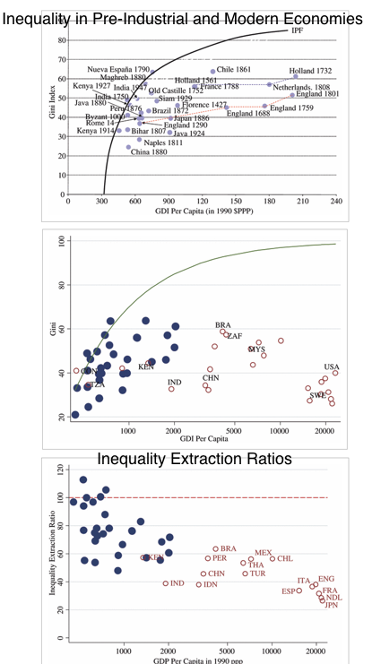
Agrarian Age Economies Look to Have Been About 80% as Unequal as They Could Have Possibly Been
Inequality in poor agrarian age economies cannot have been too great:
They are very poor…
Hence if income inequality is too great, hen poor women are too skinny to ovulate and poor children so malnourished as to have compromised immune systems
In which case they die, and so “decrease the surplus population”
And the society dies out—or becomes less unequal
<http://onlinelibrary.wiley.com/doi/10.1111/j.1468-0297.2010.02403.x/full>
2:00
Notes:
Agrarian age economies look to have been about 80% as unequal as they could have possibly been. Inequality in poor agrarian age economies cannot have been too great. Why not? Because they were very poor. Hence if income inequality was too great, then poor and working-class women would have been too skinny to ovulate and poor children so malnourished as to have compromised their immune systems. In that case they die, and so “decrease the surplus population”. And so the society dies out—or becomes less unequal.
Thus our modern societies are, typically, as unequal or more unequal than agrarian age societies.
But should this surprise us? Our rich today have enormous opportunities to spend their wealth on things that please and delight them. But back in the old days—well, consider Gilgamesh. 2/3 god and 1/3 man. Maginificent and glorious shepherd of his people. Yet his wealth could be used pretty much to eat meat, drink beer, ensure that the wool he wore was made soft. For him to even have cederwood planks to use in construction for his royal apartments required a major military expedition, and the slaying of a monster.

Slide 20
But Is That the Right Way to Look at It?
Poor people living at subsistence must be under a lot of societal pressure:
To get people to give up enough of their crop that they know that they will be hungry all the time is difficult
To get people to give up enough of their crop that they know their children will be malnourished and crying is difficult
Counting value of goods when some of the people from whom surplus is being extracted are at the margin of subsistence may be the wrong thing to do
Moreover, there is more than an economic dimension to inequality
There is status group inequality
women
slaves
subordinate castes
2:30
Notes:
But is this valuing income and valuing the amount of resources people consume the right way to look at it?
Poor people living at subsistence back in agrarian age economies must have been under awful a lot of societal pressure in order for an unequal income distribution to have been maintained.
The poor were, after all, the producers: the farmers and the craftsman. Those who extracted surplus from them had no immediate place in the process of production from which they could divert the product. It was not that the poor worked for the rich on materials provided by the rich that the rich then sold before paying wages. It was that the farmers and the craftsmen did the work, by themselves, on their farms or in their shops.
The thugs-with-spears then had to tax it, or collect it in rent.
To get people to give up enough of their crop when they know that if they do so they will be hungry all the time—that is difficult.
To get people to give up enough of their crop when they know that if they do their children will be malnourished and crying all the time—that is difficult.
Counting and comparing commodity values when some of the people from whom surplus is being extracted are at the margin of subsistence is what we do. But consider that the poor back then had their minds concentrated on how awful it would be for them to allow extraction without attempting every expedient to prevent it. The societal power gradient is a separate thing from the economic gradient, and may be a different thing. So simply counting and valuing commodities may just the wrong thing to do if we want to understand what agrarian age inequality in near-subsistence poor cultures really meant.
Moreover, there is more than an economic dimension to inequality. There is status group ineqquality as well. People get assigned to subordinate groups: subordinated castes, slaves, women, people who in the eyes of society's hierarchy are at best equal to and may be worth less than cattle. How are these distinctions created, maintained, and enforced? And what does being on the bottom side of these distinctions mean for the life even of someone—even someone who is eating relatively well, and wearing soft wool, but at the dictate and by the grace of another? Cf.: Sally Hemings.

Slide 21
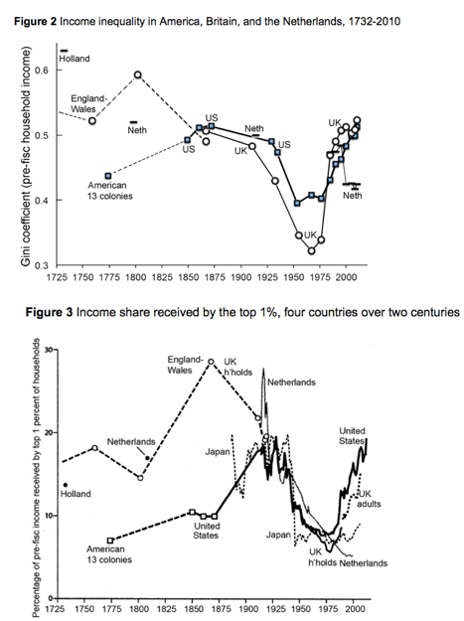
Shifts in American Inequality since 1725
Settler America initially a relatively not too unequal place:
As far as pre-industrial and early industrial economies are concerned
(For non-slaves) (and for non-women) (and for non-Indians)
Top 1% 8-10 times average, rather than 15-30 times average
Today in the U.S. top 1%—those households with incomes more than $500K/year—make 20 times average
First Gilded Age: rising inequality in the U.S., slightly falling in Europe
Age of Social Democracy
Second Gilded Age
<http://voxeu.org/article/american-growth-and-inequality-1700>
2:30
Notes:
Let me very briefly summarize the shifts in American inequality since 1725:
The America of the European settlers was initially, in the 1600s and 1700s, not too unequal a place, as far as agrarian age preindustrial and then early industrial economies were concerned.
Of course all of this is for white males, as pretty much the only people who fully counted. Slaves were unequal. Women were unequal. Amerindians—if they had survived the plagues and the wars and the forced migrations—were unequal. Even among white men, non-slaveholders in the slave south had very little societal power: If they ran their own farms, they had to sell their produce into a market in which slave-grown corn and slave-raised pigs were determining the prices that they could get. If they sought to work for others, they had to sell their labor into a market in which their potential employers' competitors would be using and driving their slaves with the whip, and thus pushing down the wages that their own employers could afford to pay.
All that said, the top one percent of white males in colonial and early federal America had maybe 8 to 10 times the average, rather than a perhaps more typical 15 to 30 times the average. (Today in the United States the top 1% of households—those households with income more than $500,000 a year—make 20 times the average.)
The coming of emancipation in 1863 and 1865 was a huge thing for economic and social equality. The coming of feminism, even early feminism, was a substantial thing for social equality if not for economic.
As far as economic equality and inequality are concerned, the post-Civil War to 1929 runup in inequality was very substantial. It changed the character of the country. Then the 1930s in the 1940s saw a great compression of wages, salaries, incomes, and wealth. After World War II the United States was, for white males, much more of a middle-class society than it had been in the First Gilded Age from 1890 to 1929.
But then the second Gilded Age began. Inequality has risen at what looks to be a historically unprecedented pace since the inauguration of Ronald Reagan in 1981. We now live in the high Second Gilded Age, with income and wealth inequality as great as or greater than it has even been before in America.

Slide 22
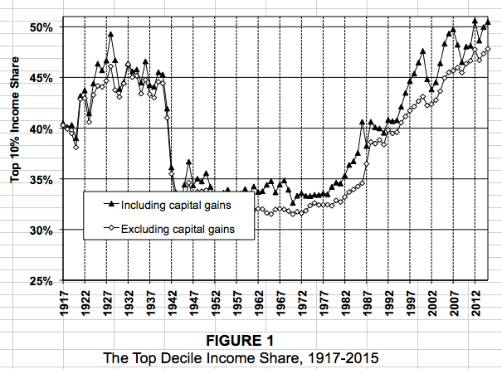
The Top-Tenth
The “tenth” are not a constant group: a quarter of people will spend at least two years in the top tenth…
These are taxpaying household units, from Piketty and Saez
2:30
Notes:
Here we see the income shares of the top tenth of Americans. These are taxpaying household units, as calculated by Thomas Piketty and Emmanuel Saez from United States Internal Revenue Service records. Now the top 10th is not a constant group: over their lives a quarter of people will spend at least two years in the top 10th. My wife and I did not hit the top 10th of household incomes until we were 28—but we have not been out of it since, and do not expect to be out of the top 10th as far as incomes are concerned until we hit our 70s, and then if we do fall out of the top 10th it will probably be because we have delayed realization of our capital gains on our assets.
Here we can clearly see the First Gilded Age, the Great Compression—in these data coming at the start of World War II—and then the 40 years of the-social democratic middle-class society. This last era was then followed by the post-Reagan inauguration coming of the second Gilded Age, and our attainment today of previously unseen levels of American inequality.
Note that in the later stages of the social-democratic era and throughout the coming of the Second Gilded Age, societal and economic equality has been increasing substantially along the dimensions of race and gender. Women make a lot more today then they did in the 1960s, and have much greater job opportunities. The gap at any particular income percentile between native-born whites on the one hand and African-Americans and Hispanic-Americans on the other has also shrunk substantially. It is the income percentiles, both within groups and for the country as a whole, that have pulled themselves much further apart.
These annual income numbers are not the income numbers we would really want to have for studying inequality. We wouldwant inequality in life chances beforehand and in life outcomes afterwards, looking over lifespans as a whole. We do know that social and economic mobility within groups has fallen considerably since the 1960s, as well as the income gradient steepening massively.

Slide 23
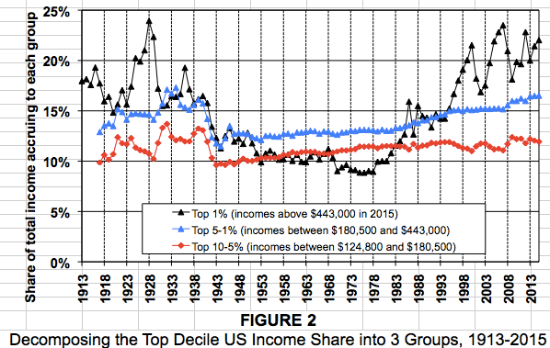
Dividing the Top-Tenth
The action within the top 10% is almost all in the top 1%
Think of it this way: the rest of us used to pay 10% of everything for the privilege of being bossed around by the top1%
Now we pay 20%. “Are we now getting our money’s worth?” is the natural question
2:50
Notes:
Here we see, in the Piketty-Saez dataset, the division of the top 10th into three groups: the top 1%, from the 1st to the 5th percentile, and from the 5th to the 10th percentile.
There is is very little action in the relative income share of the group between percentiles 5 and 10—what we might as well call our upper-middle-class. They tend to have gotten about 12% of income throughout the years since the end of World War I. That is about 2.4 times the average. Big movements in inequality have neither improved nor lessened their relative economic status and economic societal power over the past hundred years.
There is a little more action in what we might call the lower-upper-class: the people from percentile 1 to percentile 5. They received 15% of income—about 3.8 times average—back before World War II and they receive about 15 times today. They lost about 1/6 of their relative income position during the social democratic era.
The action within the top 10% is almost all in the top 1%: our upper class. Today the upper class receives about 22% of national income: a potential standard of living and a level of economic societal power 22 times the average. Back in the social democratic era they received only 10% of national income. And back before World War II, back in the First Gilded Age, they appear to have received about 16% of national income—
3/4 of their current share—save in the high boom and then bubble years of the Roaring 20s.
For our upper class of the top 1%, the years since the neoliberal era started, since the Second Gilded Age began with Ronald Reagan's inauguration, have been extraordinary years. Their relative and their absolute incomes and thus their societal power and their ability to command nature have grown at rates previously unprecedented for any upper class, anytime, any where. No wonder that you sometimes hear people talk about booms in the past 40 years! But that is not the average or of the typical experience.
One way to conceptualize what has happened in the Second Gilded Age is to note that the rest of us used to pay 10% for the privilege of being bossed around by the top 1%, who did indeed provide us with services, managerial and also technical and professional expertise-based, that the market has always valued very highly. Back then we paid 10%. Now we pay 22%. The natural questions to ask are then: Are we now getting our money's worth? Were we back then getting a major bargain by exploiting our rich?
Here we see, in the Piketty-Saez dataset, the division of the top 10th into three groups: the top 1%, from the 1st to the 5th percentile, and from the 5th to the 10th percentile.
There is is very little action in the relative income share of the group between percentiles 5 and 10—what we might as well call our upper-middle-class. They tend to have gotten about 12% of income throughout the years since the end of World War I. That is about 2.4 times the average. Big movements in inequality have neither improved nor lessened their relative economic status and economic societal power over the past hundred years.
There is a little more action in what we might call the lower-upper-class: the people from percentile 1 to percentile 5. They received 15% of income—about 3.8 times average—back before World War II and they receive about 15 times today. They lost about 1/6 of their relative income position during the social democratic era.
The action within the top 10% is almost all in the top 1%: our upper class. Today the upper class receives about 22% of national income: a potential standard of living and a level of economic societal power 22 times the average. Back in the social democratic era they received only 10% of national income. And back before World War II, back in the First Gilded Age, they appear to have received about 16% of national income—
3/4 of their current share—save in the high boom and then bubble years of the Roaring 20s.
For our upper class of the top 1%, the years since the neoliberal era started, since the Second Gilded Age began with Ronald Reagan's inauguration, have been extraordinary years. Their relative and their absolute incomes and thus their societal power and their ability to command nature have grown at rates previously unprecedented for any upper class, anytime, any where. No wonder that you sometimes hear people talk about booms in the past 40 years! But that is not the average or of the typical experience.
One way to conceptualize what has happened in the Second Gilded Age is to note that the rest of us used to pay 10% for the privilege of being bossed around by the top 1%, who did indeed provide us with services, managerial and also technical and professional expertise-based, that the market has always valued very highly. Back then we paid 10%. Now we pay 22%. The natural questions to ask are then: Are we now getting our money's worth? Were we back then getting a major bargain by exploiting our rich?

Slide 24
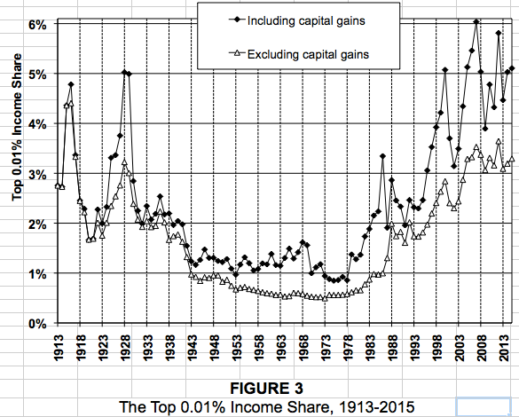
The Overclass
And the top 0.01%?
We pay 5 times as great a share of income now as in the 1970s for whatever they do. 15,000 households. $60 million year for each…
1:00
Notes:
And now we come to our overclass: the top 0.01%. These are 15,000 households in the United States of America. Their incomes average 60 million a year. Today, we pay five times as much to the overclass for them to perform the services for society that they do. What do the rest of us get in return? And how is it that it is this category of income that has been so greatly amplified in the Second Gilded age: the overclass share is now 2/3 greater than it was even back in the first Gilded Age.
5% of national income for 0.01% of the population means that these 15,000 households collectively have 500 times average income. Back in 1970 their counterparts had only 100 times average income. What has happened to our market economy and our system of property ownership to generate this change?

Slide 25

Six Sources of Rising Inequality—so Far
Six factors that matter:
The race between education and technology
Dissipative sectors: finance
Dissipative sectors: healthcare
Collapse of worker bargaining power
Low-pressure economy
Winner take all
Three that do not:
“Bad trade deals”
Low-education immigration (save for its effects on earlier waves still not fully proficient in English)
Affirmative action (Arlie Hochschild)
2:00
Notes:
There have, at least so far, been six important sources and causes of rising inequality in the Second Gilded Age. And there are three things that are often blamed for rising inequality that are simply not so.
The six factors that matter are:
1. The race between education and technology, which education has lost over the past 40 years
2. The rise of a dissipative sector: finance. It consumes a huge amount of national income, yet it is hard to see what services it provides us that its much cheaper predecessor sector two generations ago did.
3. The rise of healthcare as a dissipative sector as well. Everyone believes we get enormous value from our health care sector. The problem is that our peer nations get the same value, or better value, from a health care sector that costs them one-third as much.
4. The collapse of worker bargaining power with the decline of the union movement
5. A low pressure high unemployment economy has been typical of the past 40 years
6. Changes in technology have created more winner-take-all markets, in which those who have or are thought to have special skills and expertise profit mightily.
The three factors that do not matter are:
1. "Bad trade deals".
2. Low-education immigration—save for the effects of low-skill immigration on earlier waves of immigrants still not fully proficient in English, with whom they do compete and whose wages they push down. But otherwise? Low-skill and low-education immigrants take jobs for which English proficiency is not a requirement, and native-born who would have taken those jobs otherwise find equivalently paid jobs for which English proficiency is a requirement.
3. Affirmative action—often blamed, but simply not a thing.

Slide 26
But Is That the Right Way to Look at It?
Poor people living at subsistence must be under a lot of societal pressure:
To get people to give up enough of their crop that they know that they will be hungry all the time is difficult
To get people to give up enough of their crop that they know their children will be malnourished and crying is difficult
Counting value of goods when some of the people from whom surplus is being extracted are at the margin of subsistence may be the wrong thing to do
Moreover, there is more than an economic dimension to inequality
There is status group inequality
women
slaves
subordinate castes
2:30
Notes:
But is this valuing income and valuing the amount of resources people consume the right way to look at it?
Poor people living at subsistence back in agrarian age economies must have been under awful a lot of societal pressure in order for an unequal income distribution to have been maintained.
The poor were, after all, the producers: the farmers and the craftsman. Those who extracted surplus from them had no immediate place in the process of production from which they could divert the product. It was not that the poor worked for the rich on materials provided by the rich that the rich then sold before paying wages. It was that the farmers and the craftsmen did the work, by themselves, on their farms or in their shops.
The thugs-with-spears then had to tax it, or collect it in rent.
To get people to give up enough of their crop when they know that if they do so they will be hungry all the time—that is difficult.
To get people to give up enough of their crop when they know that if they do their children will be malnourished and crying all the time—that is difficult.
Counting and comparing commodity values when some of the people from whom surplus is being extracted are at the margin of subsistence is what we do. But consider that the poor back then had their minds concentrated on how awful it would be for them to allow extraction without attempting every expedient to prevent it. The societal power gradient is a separate thing from the economic gradient, and may be a different thing. So simply counting and valuing commodities may just the wrong thing to do if we want to understand what agrarian age inequality in near-subsistence poor cultures really meant.
Moreover, there is more than an economic dimension to inequality. There is status group ineqquality as well. People get assigned to subordinate groups: subordinated castes, slaves, women, people who in the eyes of society's hierarchy are at best equal to and may be worth less than cattle. How are these distinctions created, maintained, and enforced? And what does being on the bottom side of these distinctions mean for the life even of someone—even someone who is eating relatively well, and wearing soft wool, but at the dictate and by the grace of another? Cf.: Sally Hemings.

Slide 27
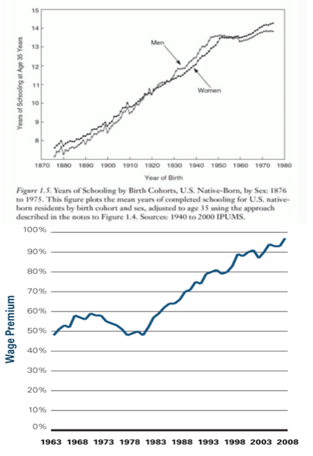
Sources of Rising Inequality I: The Race Between Education and Technology
America began charging for (public) colleges in the 1970s
Initially a good-government move—college graduates were going to be rich, and making them pay seemed a progressive reform that took pressure off of state budgets
But as college became expensive, lots of people who ought to have gone to college didn’t
We lost the race between education and technology
And thus income inequality in the form of the college-high school wage premium leaped upward
This could be fixed—over generations

Slide 28
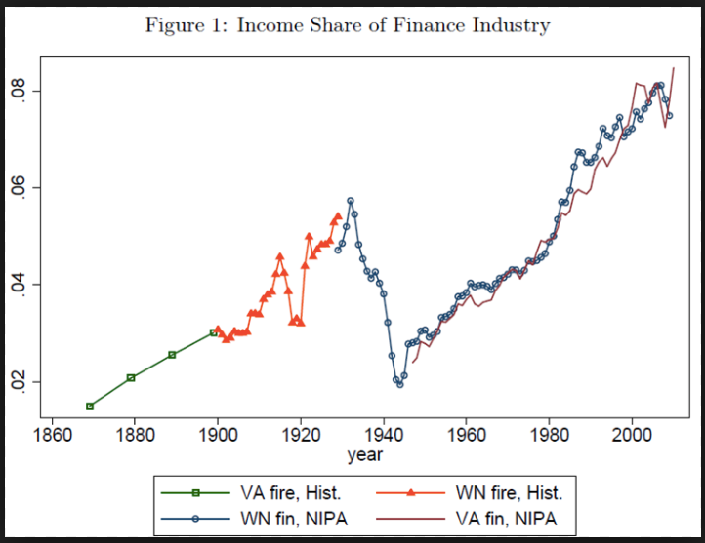
Sources of Rising Inequality II: Dissipative Sectors: Finance
The rise of superincomes in finance
And in the related corporate over-structure paid as if they were financiers
This is a great puzzle:
People pay financiers voluntarily
Finance is much more competitive than in the 1960s
Finance much more steeply peaked than it was in the 1960s

Slide 29
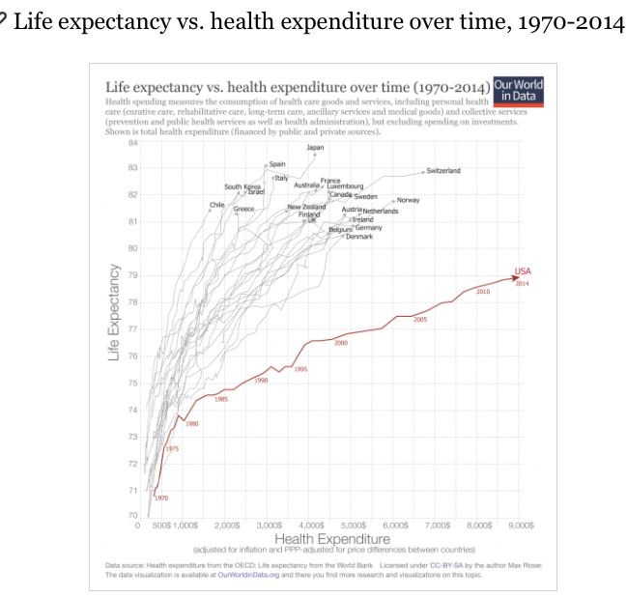
Sources of Rising Inequality III: Dissipative Sectors: Health Care
U.S. health care financing becomes dysfunctional starting with the Reagan administration
Failed 1993 HilaryCare effort blocked by Republicans
We will see what ObamaCare does
Elsewhere in the world, doctors are well-paid—not superpaid..

Slide 30
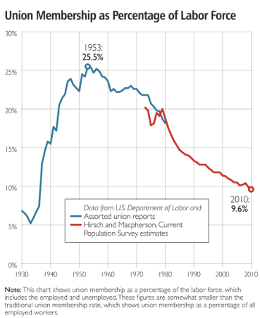
Sources of Rising Inequality IV: Collapse of Worker Bargaining Power
The war against the union movement
“Monopoly” and “voice” face of the union movement
Strong monopsony employer element
Deunionization a significant negative for productivity
A transfer away from workers

Slide 31
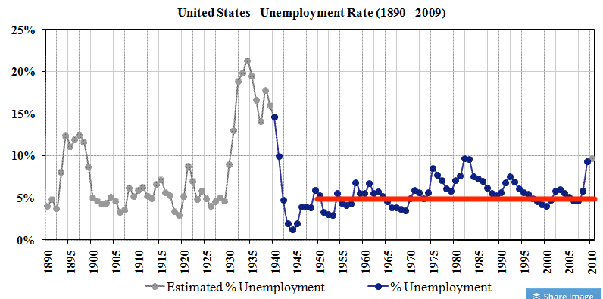
Sources of Rising Inequality V: Low-Pressure Economy

Slide 32
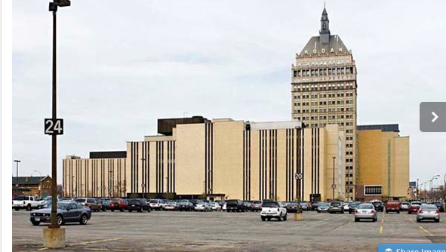

Sources of Rising Inequality VI: Winner Take All
Kodak vs. Google
Rochester vs. Mountain View
Middle-class prosperity for a region fueled by a critical mass of well-paying engineering and technical jobs
Winner-take-all billionaires and hundred millionaires…

Slide 33
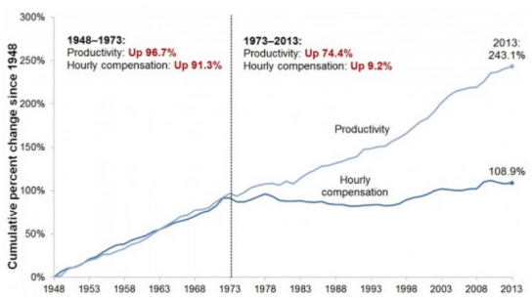
How Much Difference Does It Make?
The coming of Gilded Age II coincided with the productivity slowdown, and has produced wage and income stagnation for others…
But remember: social equality—minorities and women

Slide 34
What Happens Next?
The “leaky bucket”
Which way does the bucket travel?
Social democracy reduces the incentives of the rich and non-rich to work?
Higher inequality gives the rich more power and more of a stake in rent-seeking?
Who is creatively destroyed by creative destruction?
How much does the bucket leak?

Slide 35
Future Sources of Rising Inequality: Thomas Piketty’s Argument
“Capital” keeps the real rate of return at 5%.
In the Age of Social Democracy:
Population growth at 2%/year
Productivity growth at 2%/year
Conspicuous consumption/philanthropy/taxes at 3%/year
Means Old Capital gets eroded—the rich are entrepreneurs and enterprisers
In a Gilded Age
Population growth at 0.5%/year
Productivity growth at 1%/year
CC/P/T at 2%/year
Means Old Capital becomes dominant—the rich are, eventually, heirs and heiresses, and are very rich indeed with very large voices in politics

Slide 36
Criticisms of Piketty’s Argument
Can “capital” keep the real rate of return at 5%?
You would think that more capital would compete with itself for the services of workers to operate it, and so the rate of profit would fall…
What Keynes called “the euthanasia of the rentier”
More a story about Europe than about America
Europe is the place with ZPG
Europe is the place with less dynamic growth and less creative destruction
America’s rich are overwhelmingly entrepreneurs and superincome earners—not (or at least not yet) heirs and heiresses (but Waltons, Kochs, Trump)

Slide 37
Inequality and Growth: Big-Picture Evidence?
There is basically no pattern—either in the United States or elsewhere
Growth was fastest in the 1940s, 50s, and 60s in which income inequality was low
Growth was lowest in the 1970s (low), 1980s (low but rising), and 2000s (high)
Growth had a recovery in the 1990s (moderate but rising)
Growth was fast in the 1920s (high)
But the 1930s were a disaster…
Think that redistributing income either way is going to unleash growth, and you are mistaken
In which case why not do the utilitarian thing?

Slide 38

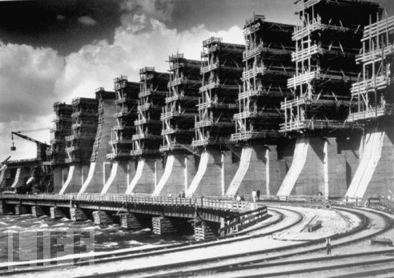
Except for the Experience of Communism…
High Stalinist central planning
Marx’s suspicion of markets as surplus-extraction devices
Hence, the communists said, we won’t have any
We will reproduce the Rathenau-Ludendorff World War I Imperial German war economy
Communes, economies of scale, GOSPLAN, etc.
Effect: you throw away a five-fold amplification of productivity by eschewing the market

Slide 39
What Happens Next?
The “leaky bucket”
Which way does the bucket travel?
Social democracy reduces the incentives of the rich and non-rich to work?
Higher inequality gives the rich more power and more of a stake in rent-seeking?
Who is creatively destroyed by creative destruction?
How much does the bucket leak?

Slide 40
What Should We Aim For?
Democratic politics decides on distribution, and then business of economists to maximize production—boost average incomes…
The utilitarian view: inequalities “justified” when they lead to a positive average percentage change in incomes…
Rawlsian: inequalities “justified” only when they lead to a better life for the worst off…
Inequalities justified when they reward the “worthy”…
Inequalities justified when they allow for philosophy…
Inequalities justified when they are the result of a fair system…

Slide 41
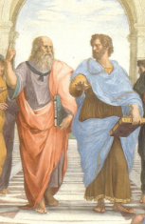
But What Is This “Fair”?
In the opening of Plato’s Republic:
Sokrates: "Well said, Kephalos; but as concerning justice, what is it?"
Kephalos: "To speak the truth and to pay your debts.”
The whole point of the opening of Plato’s Republic is that acting fairly—not cheating or stealing from people—does not by itself justice make.
But it is an essential part: people need to believe that they are neither cheaters nor cheated…

Slide 42
Discussion
Inequality and Plutocracy:
What strikes you as important here?

Slide 43
Big Ideas: Lecture 16: Inequality and Plutocracy
Takeaways from this class:

Slide 44
Catch Our Breath…
Ask a couple of questions?
Make a couple of comments?
Any more readings to recommend?

Slide 45
Notes

Slide 46
Reviews…

Slide 47
Review: Commercial Revolutions
Exploration and Conquest and Market Extension:
Zheng He: 1405-33: 7 expeditions—300 ships ??, 30,000 crew??, as far as Malindi. 400 feet long??:
“We have traversed more than 100,000 li of immense water spaces and have beheld in the ocean huge waves like mountains rising in the sky, and we have set eyes on barbarian regions far away hidden in a blue transparency of light vapors, while our sails, loftily unfurled like clouds day and night, continued their course [as rapidly] as a star, traversing those savage waves as if we were treading a public thoroughfare…”, quoted in Louise Levathes (1996): When China Ruled the Seas: The Treasure Fleet of the Dragon Throne, 1405–1433
Bartolomeu Dias: 1487-8: 3 ships, rounded the Cape of Good Hope at the southern tip of Africa. 80 feet long, 30 men/ship
Cristoforo Colombo: 1492: 3 ships, 90 men.
Vasco da Gama: 1498: 4 ships, 170 men to India and back
9:45-10:00

Slide 48
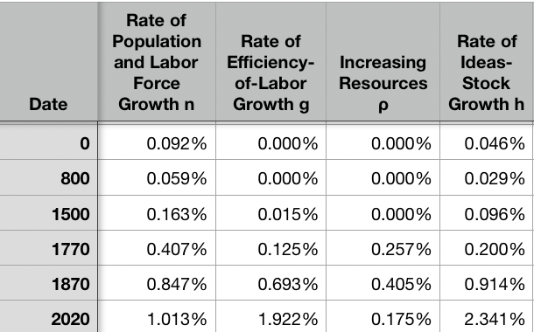
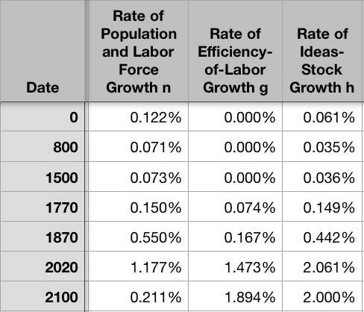
Resources! And Political Economy!
“The Advanced West”
The Columbian Exchange
Corn, the potato, chocolate, &c.: substantial boost to calories
Benefits everywhere!
But one-sided: Europe gains empire and resources wherever its ships can sail and cannon can shoot
Sugar islands and the slave trade
400 calories per Briton per day by 1750?
The underdevelopment of Africa
12.5 million Atlantic African slave trade
(2 million Mediterranean, 4 million Black Sea, 1 million Viking, 17 million Indian Ocean, 30 million Graeco-Roman)
The East Indies
Spices—later silks, porcelain, cottons: 80% fall in real price
Benefits everywhere
But benefits one-sided: disassembling a mountain of silver in Peru in order to import luxuries from China, India, Malaysia, and Indonesia…
Political Economy
The merchants of Bristol, the nabobs, the King of Spain: New wealth to add in to the scales…
Inflation
The World
9:45-10:00

Slide 49
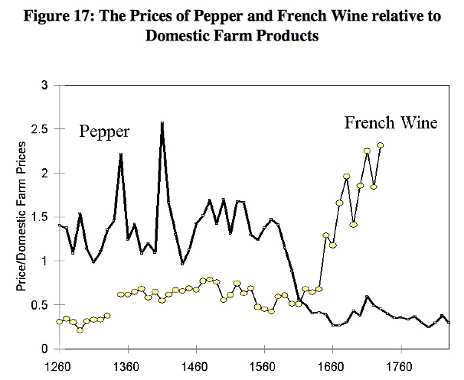
Clark, “The Secret History of the Industrial Revolution”
9:45-10:00

Slide 50
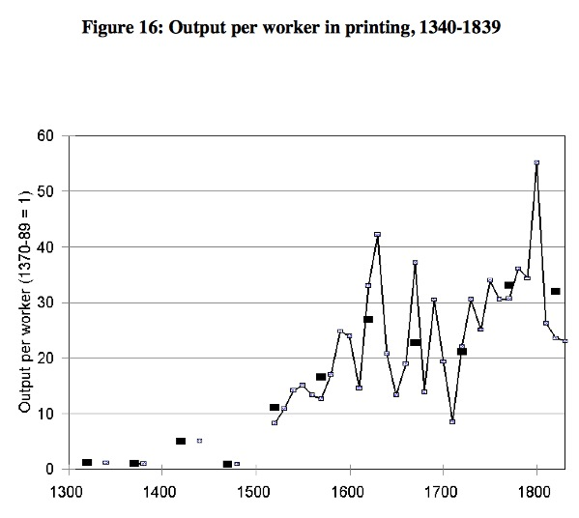
Clark, “The Secret History of the Industrial Revolution”
9:45-10:00

Slide 51
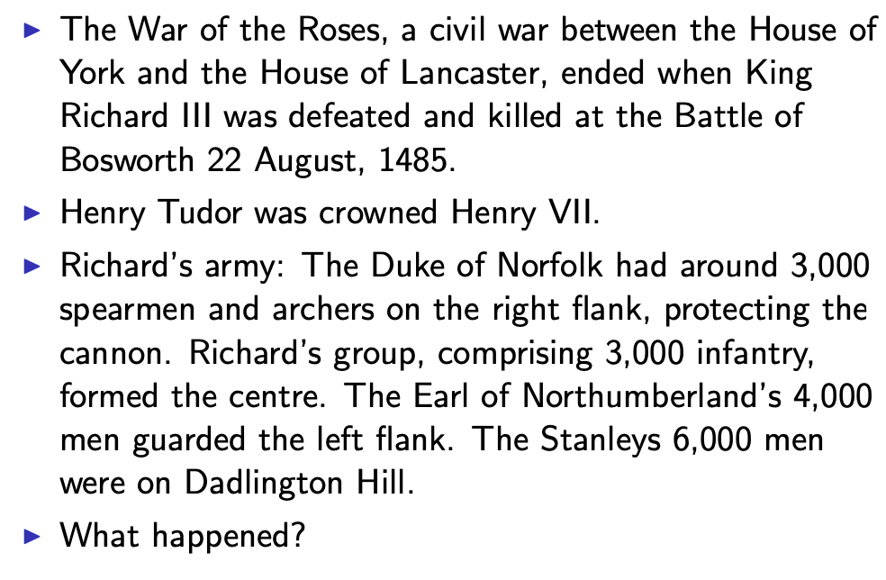
Establishing an Effective Monopoly of Violence: Wars of the Roses
10:10-10:20
Slide taken from Melissa Dell

Slide 52
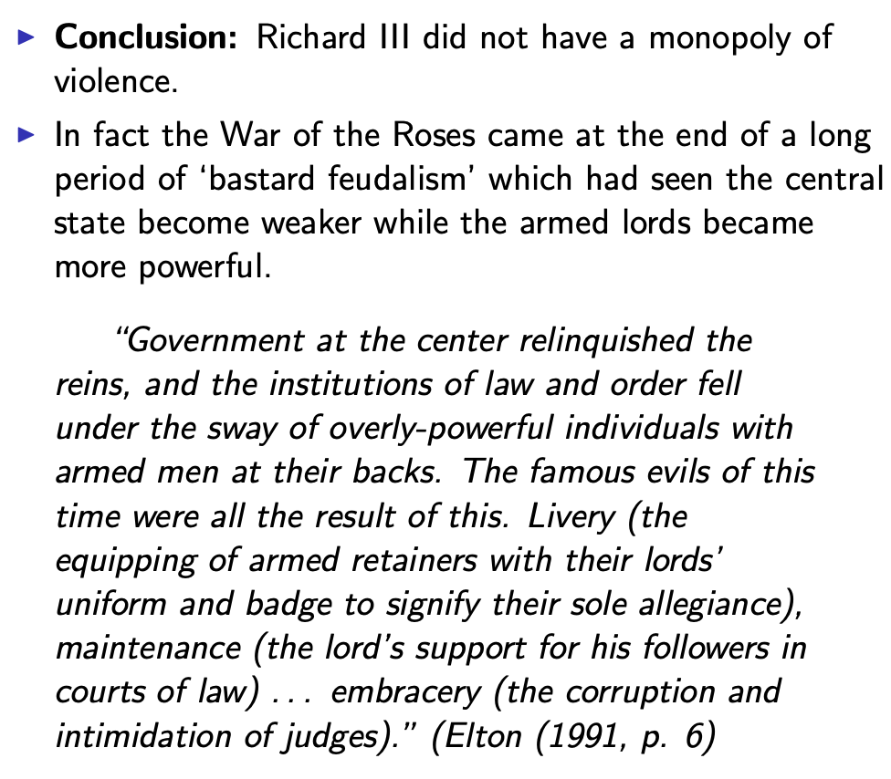
Establishing an Effective Monopoly of Violence: Implications of the Treason of the Stanleys
10:10-10:20
Slide taken from Melissa Dell

Slide 53
Marcher Lords: Warwick the Kingmaker
Adam Smith: “The great Earl of Warwick is said to have entertained every day, at his different manors, 30,000 people; and though the number here may have been exaggerated, it must, however, have been very great to admit of such exaggeration. A hospitality nearly of the same kind was exercised not many years ago in many different parts of the Highlands of Scotland…
10:10-10:20

Slide 54
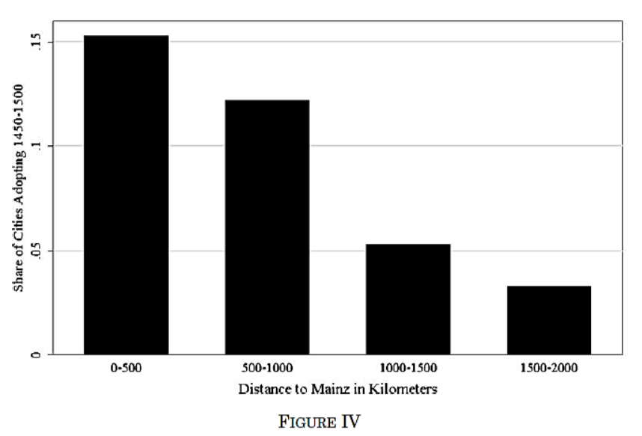
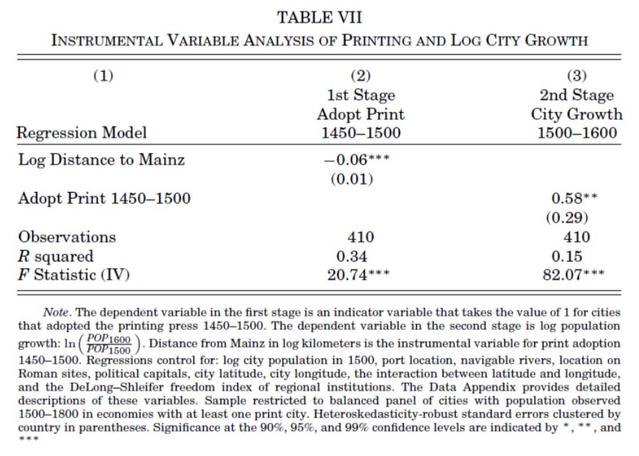
Jeremiah Dittmar (2011): The Printing Press as an Agent of Change… II
Dittmar’s Test: Compare (especially over the period 1500– 1600) population growth of cities that did and did not adopt the printing press before 1500.
Why are DIttmar’s IV estimates so big? 0.6 per century—a near doubling—as opposed to 0.2?
10:10-10:20

Slide 55
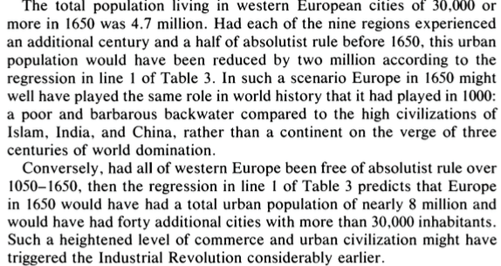
DeLong and Shleifer I
It’s a big deal…
10:10-10:20

Slide 56
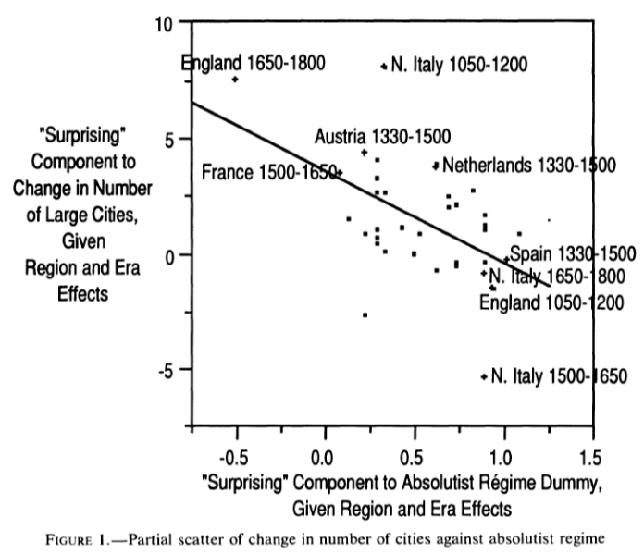
DeLong and Shleifer III
Northern Italy in 1500-1650 is “surprising” as absolutist then
England 1650-1800 is “surprising” as non-absolutist then
WTF?! with the Italian urban boom 1050-1200
Econometric problems
Normal distribution—we have only 45 observations, and 30 degrees of freedom…
The file-drawer problem…
10:10-10:20

Slide 57
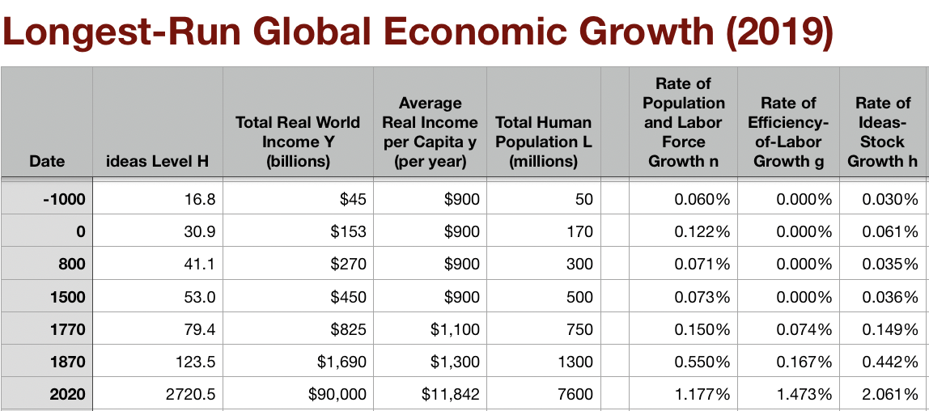
Discussion
“Commercial Society” of the Eighteenth Century
An extra 1500 years of invention and innovation, yes…
Scope of control…
Columbian Exchange…
But, otherwise, how different from Antonine Rome or Sung China or Abbasid Mesopotamia?
It did occur in Antonine Rome…
Temin: no industrial revolution…
10:35-10:50

Slide 58
Review: Adam Smith
We Have a Very Keen-Eyed Contemporary Observer:
Read: Christopher Berry (2018): Adam Smith: A Very Short Introduction, chs. 1, 4-6 <https://delong.typepad.com/files/berry-smith.pdf>
The market economy as a game changer
Commercial society:
Hunter, shepherd, agricultural, and commercial stages…
“It is Smith’s explicit reference to a ‘commercial society’ that is distinctive and Smith here is a pioneer…”
Agrarian-Age power lies with the owners of land, and government is ‘a combination of the rich to oppress the poor’
Commercial society sees the growth of the rule of law—and a government that can enforce its property-rights order against local notables, roving bandits, and its own functionaries…
10:15-10:35

Slide 59
Why the Emergence of “Commercial Society”
Friedrich Engels:
“Exceptional periods, however, occur when the warring classes are so nearly equal in forces that the state power, as apparent mediator, acquires for the moment a certain independence in relation to both. This applies to the absolute monarchy of the seventeenth and eighteenth centuries, which balances the nobility and the bourgeoisie against one another; and to the Bonapartism of the First and particularly of the Second French Empire, which played off the proletariat against the bourgeoisie and the bourgeoisie against the proletariat. The latest achievement in this line, in which ruler and ruled look equally comic, is the new German Empire of the Bismarckian nation; here the capitalists and the workers are balanced against one another and both of them fleeced for the benefit of the decayed Prussian cabbage lords…” Origin of the Family…
It was in the kings’ and their bureaucracies’ interests—and they were (sometimes) able to make it stick.
10:15-10:35

Slide 60
Why the Emergence of “Commercial Society” II
Adam Smith, according to Berry:
“The feudal lords were masters… settled disputes, enforced discipline, and commanded their tenants to fight on their behalf….. [But] when foreign commerce introduced… what Smith deliberately calls frivolous and useless goods (he mentions diamond buckles) the lords sold off their land or granted long leases… undermine[d] their power to command and their ability to act as judges because those who had been previously dependent became independent: ‘For the gratification of the most childish, the meanest and the most sordid of all vanities’… these landlords gradually bartered away their whole power and authority (WN 419)…
“Smith calls this change a ‘revolution of the greatest importance to the publick happiness’ (WN 422)
But it was not brought about with the deliberate aim to further the public good…
It was, rather, an example of unintended consequences.
This made possible the ‘regular administration of justice’.
The establishment of that uniformity is crucial
Without it a commercial society is not possible
10:15-10:35

Slide 61
Once You Have the Preconditions for “Commercial Society”…
Commercial Revolution Prosperity:
“Universal opulence which extends itself to the lowest ranks of the people…”
Because of the division of labor…
Possible only in a well-governed society…
Berry: “Through the division of labour ten individuals could make 48,000 pins a day—equivalent to 4,800 each. But if each individual performed all the tasks required (drawing, straightening, cutting, pointing the wire, and so on) then less than twenty would have been manufactured. He gives three reasons for this: increased dexterity that comes from reducing each individual’s task to ‘one simple operation’; time-saving that stems from not having to transfer from one task to the next; and inventing better ways of executing the task prompted by the concentration on one task…”
Division of labor depends on the extent of the market…
And self-interest: “it is not from the benevolence of the butcher, the brewer or the baker that we expect our dinner, but from their regard to their own interest. We address ourselves not to their humanity but to their self- love and never talk to them of our own necessities but of their advantages. Nobody but a beggar chuses to depend chiefly upon the benevolence of his fellow-citizens…”
10:15-10:35

Slide 62

Smith’s “System of Natural Liberty”
Depends on Universal Principles: Smith according to Berry:
A ‘science of human nature’.
The self-interested hope of everyone to better their own condition.
The moral principle that everyone is free.
Individuals are the best judges of their own interests
The outcomes of particular exchanges redound unintentionally to the general benefit.
The ‘miserable poverty’ of the savage nations, as depicted in his Introduction, is left behind
The twin blessings of opulence and freedom are experienced.
10:15-10:35

Slide 63
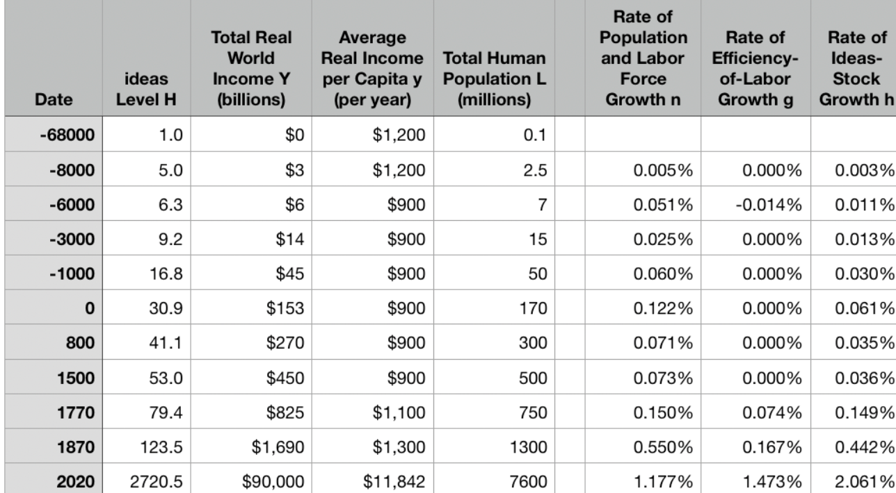
Review: Why Was Pre-Industrial Progress so Slow on Average?
Our readings:
Willem M. Jongman (2007): Gibbon was Right: The Decline and Fall of the Roman Economy <https://delong.typepad.com/jongman-gibbon-was-right.pdf>
Peter Temin: The Roman Market Economy, Roman Growth <https://delong.typepad.com/files/temin-roman-growth.pdf>
Moses Finley: Technical Innovation and Economic Progress in the Ancient World <https://delong.typepad.com/finley-technical.pdf>
Josh Ober (2019): Agamemnon's Cluelessness, selections <https://delong.typepad.com/files/ober-agamemnon-selections.pdf>

Slide 64
Potential Points of View
What are the possibilities here?:
No puzzle—given how few heads they had, and given the absence of printing and the difficulty of controlled experiments, it is a miracle that they managed to advance technology as far as they did as fast as they did… (Kremer)
No: there was something wrong. They had the wrong kind of society… (Finley, critiqued by Ober)
No: something went wrong: civilization seems to be progressing up to the year 1… 0.013%/yr… 0.030%/yr… 0.061%/yr… & then it stalls out: instead of doubling to a Commercial Revolution rate of growth after the year 1, the rate of ideas growth halves again… (Jongman)

Slide 65
Our Four Readings
What possibilities do they argue for?:
Jongman:
“Population went down… production per man hour must have gone up…. The Roman Empire should have turned into a world of happy and prosperous peasants…. Reality was, of course, different… the emergence of a new social, political, and legal regime, where oppression replaces the entitlements of citizenship…”
Temin:
“The high ratio of wages to energy costs was not only absent in eighteenth-century continental Europe; it was absent as well in the Roman Empire…. There was no possibility of escaping from the Malthusian constraints… no possibility that industrialization could have begun in the ancient world…”
Finley:
“The pejorative judgments of ancient writers about labour, and specifically about the labour of the artisan, and of anyone who works for another, are too continuous, numerous, and unanimous, too wrapped up in discussions of every aspect of ancient life, to be dismissed as empty rhetoric. In other slave-owning societies for whom there is fuller documentation, these implications and their practical effects are unmistakable. Writing about the Great Trek, for example, Sir Keith Hancock said: 'The Boers very soon convinced themselves that artisans' work and slaves' work were the same thing—a conviction which struck such deep roots in their minds that their descendants in the nineteenth century left to British immigrants almost all the opportunities of skilled industrial employment in the expanding towns'. Or Tocqueville, whose I83I notebooks are filled with the theme that 'slavery is even more prejudicial to the masters than to the slaves', because, as a leading Louisville merchant said to him, 'it deprives us of the energy and spirit of enterprise that characterizes the States that have no slaves’…. Comparisons must be made with caution and reserve. But this particular one seems to me to be valid and necessary…”
Ober:
“Greeks were quite capable of the kind of reasoning necessary to build and sustain a growing economy…. Ancient Greeks, as individuals and collectives, frequently employed… rationally instrumental reasoning in economic contexts. It is nonetheless undeniable that there is a body of classical literature that exemplifies the scorn for money-making that was emphasized by the Finley school. Those expressions of scorn underpin the theory of an essentially timeless and changeless ancient economy predicated on violent extraction and gift exchange…. The approach of the Socratic philosophers to economic rationality was fundamentally critical and normative…. For Finley and his school… any activity that was not grounded in status, and in [its] power relations… was… unmoored and ephemeral…. Economic activity aimed at increasing productivity, innovations aimed at increasing efficiency, and increased consumption—rather than securing the status of the relevant actors—were, thereby, rendered more or less invisible—and in any event, unworthy of detailed study. The result was, so I suppose, both a misunderstanding of the relevant texts and a misrepresentation of the underlying social reality…”

Slide 66
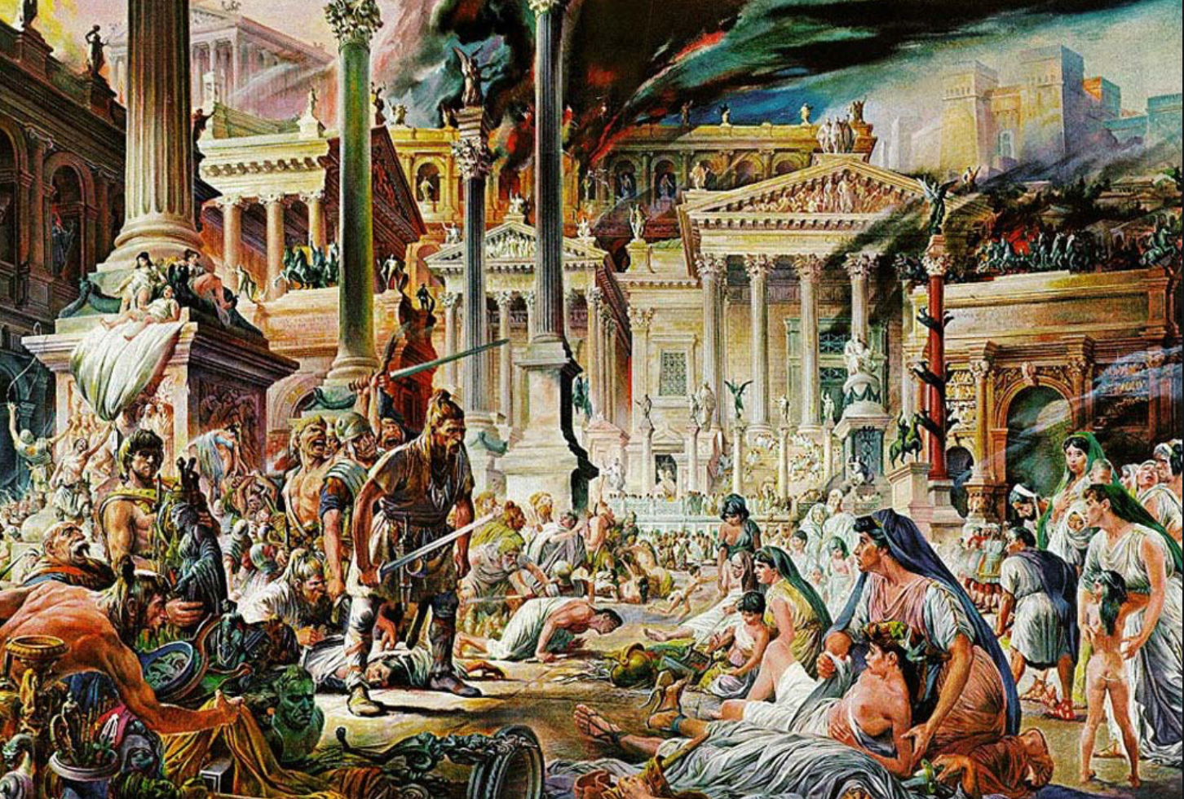
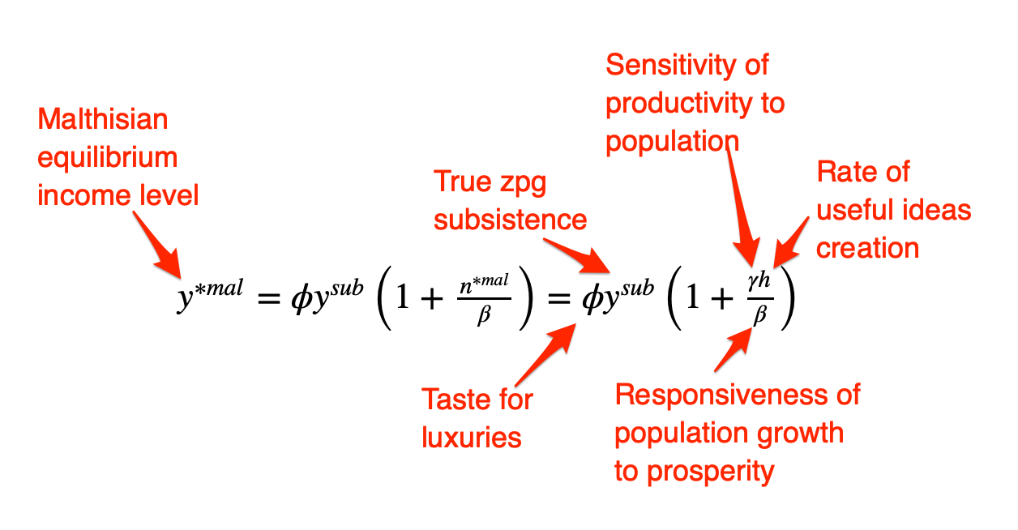
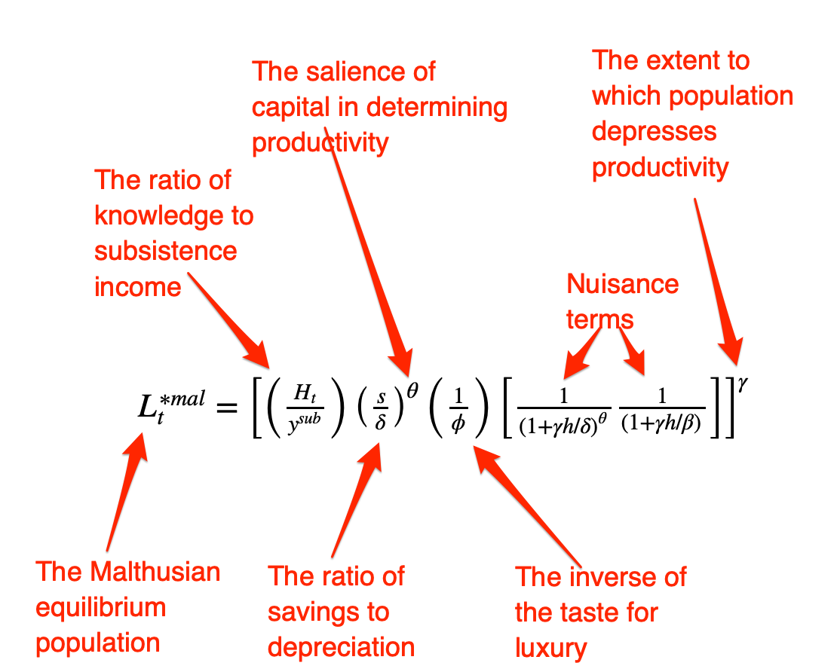
Review: The Fall of Rome
Economic Zenith, Then Economic Decline, Then Political Decline:
While the existing data are somewhat contradictory, the consensus amongst archaeologists is the early 2nd century.
A new social distinction between honestiores (high status) and humiliores (low status with different laws) was introduced.
Citizens began to lose their rights and by the end of the 2nd century, they were being tied to the land as serfs
The Barbarians were at the gates, but it seems reasonable to see this as an outcome of the weakening of Roman institutions
Earlier Rome had defeated far more formidable and better organized enemies like the Carthaginians.
Acemoglu and Robinson argue that the big fact about what preceded the decline is that political institutions moved in a much more extractive direction and this was followed by economic institutions.
Jongman (“Gibbon was Right”) proposes that the Antonine plague which hit the Roman Empire around 160AD is the most likely explanation for the collapse of Rome.
But Malthusian crises are supposed to increase living standards, not reduce them: so what is going on?
Slide taken from Melissa Dell

Slide 67
Three Great Plagues
But the demands of the empire for revenue and of the upper class for resources remain the same:
Antonine Plague (smallpox?): Antonine ⇒ Severian dynasty
Plague of St. Cyrian (Ebola-like?): Things fall completely apart, then Diocletian: between Philip the Arab and Diocletian, 18 emperors in 35 years, plus two breakaways; 12 of the 18 were assassinated
Plague of Justinian (Bubonic): Flavius Apion…

Slide 68
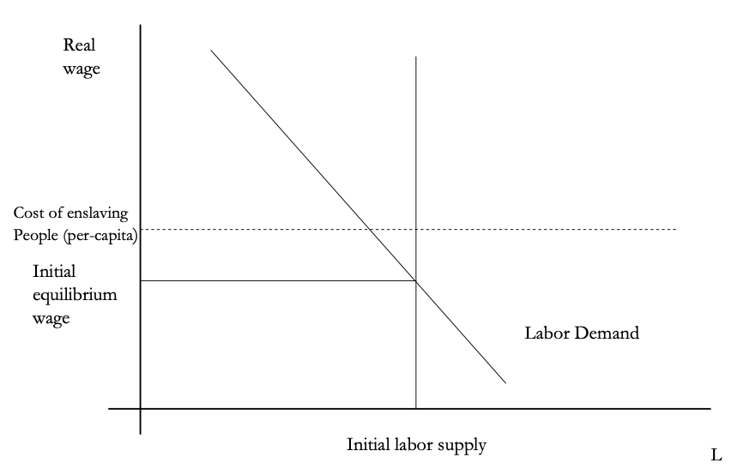
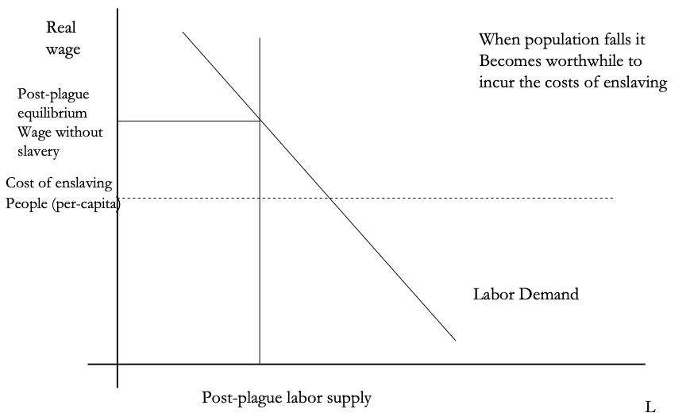
The Domar Hypothesis
You can have a leisured upper class, or abundant land relative to labor, or free labor, but not all three at once:
Slide taken from Melissa Dell

Slide 69
The Later Roman Empire
How does it compare to the expanding Roman Republic?
Militarism: in striking contrast to earlier days, a successful general is a threat to the emperor. Eighteen emperors in 35 years between Philip the Arab and Diocletian
Mobilization: In order to extract resources from a smaller population, the people must be disarmed rather than mobilized.
Distribution: The smaller pool of benefits needs to be hoarded for those with connections, not shared.
Incorporation: You can join the Goths: you cannot join the Roman upper class unless you know someone…

Slide 70
Dell’s Summary of Acemoglu and Robinson on the Rise and Fall of Rome II
For the Roman Empire, the collapse of Roman authority was pronounced, particularly in the West:
By 450AD all the trappings of Roman economic prosperity were gone.
Money vanished from circulation.
Urban areas were abandoned and buildings stripped of stone.
The roads were overgrown with weeds.
The only type of pottery which was fabricated was crude and hand made, not manufactured.
People forgot how to use mortar and they also forgot how to read and write.
Roofs were made of branches, not tiles.
The Eastern Roman Empire lived on, but it contracted significantly with the rise of Islam in the 7th Century.
Slide taken from Melissa Dell

Slide 71
Review: Republic to Empire
Political transition:
The expansion of Rome’s conquests created inequality and increasing political instability.
There were calls for the redistribution of land and power.
For example, Plebeian Tribune Tiberius Gracchus started to develop very ‘populist’ political platforms which threatened the senatorial elites.
The culmination of this was civil war, the dictatorship of Julius Caesar, and finally the creation of the Empire under Augustus.
First the principate
Then the dominate
Augustus reformed the army, removing it as a bastion of plebeian power.
His successor Tiberius stripped the assemblies of powers and gave them to the senate—and then neutered the senate
A semi-hereditary monarchy replaced the Republic:
“May good success attend the Roman senate and people and myself. I hereby adopt as my son Marcus Ulpius Nerva Traianus…”
This was a move towards more “extractive” political institutions and though it stabilized things for awhile, there was an eventual movement towards even more extractive economic institutions
Slide taken from Melissa Dell

Slide 72
Always Scribble, Scribble, Scribble! Eh! Mr. Gibbon?
Beste, Memorials:
The Duke of Gloucester, brother of King George III, permitted Mr. Gibbon to present to him the first volume of The History of the Decline and Fall of the Roman Empire. When the second volume of that work appeared, it was quite in order that it should be presented to His Royal Highness in like manner. The prince received the author with much good nature and affability, saying to him, as he laid the quarto on the table,
“Another damned thick, square book! Always, scribble, scribble, scribble! Eh! Mr. Gibbon?”

Slide 73
Always Scribble, Scribble, Scribble! Eh! Mr. Gibbon?
Five Good Emperors: Nerva-Trajan-Hadrian-Antonius Pius-Marcus Aurelius:
If a man were called to fix the period in the history of the world, during which the condition of the human race was most happy and prosperous, he would, without hesitation, name that which elapsed from the death of Domitian to the accession of Commodus.
The vast extent of the Roman empire was governed by absolute power, under the guidance of virtue and wisdom.
The armies were restrained by the firm but gentle hand of four successive emperors, whose characters and authority commanded involuntary respect.
The forms of the civil administration were carefully preserved by Nerva, Trajan, Hadrian, and the Antonines, who delighted in the image of liberty, and were pleased with considering themselves as the accountable ministers of the laws.
Such princes deserved the honor of restoring the republic, had the Romans of their days been capable of enjoying a rational freedom.
The labors of these monarchs were overpaid by
the immense reward that inseparably waited on their success;
by the honest pride of virtue, and
by the exquisite delight of beholding the general happiness of which they were the authors.

Slide 74
Aelius Aristides
The Roman Oration:
Whatever the seasons make grow and whatever countries and rivers and lakes and arts of Hellenes and non-Hellenes produce are brought from every land and sea, so that if one would look at all these things, he must needs behold them either by visiting the entire civilized world or by coming to this city. For whatever is grown and made among each people cannot fail to be here at all times and in abundance. And here the the merchant vessels come carrying these many products from all region in every season and even at every equinox, so that the city appears a kind of common emporium of the world.
Cargoes from India and, if you will, even from Arabia the Blest one can see in such numbers as to surmise that in those lands the trees will have been stripped bare and that the inhabitants of these lands, if they need anything, must come here and beg for a share of their own. Again one can see Babylonian garments and ornaments from the barbarian country beyond arriving in greater quantity and with more ease than if shippers from Naxos or from Cythnos, bearing something from those islands, had but to enter the port of Athens. Your farms are Egypt, Sicily and the civilized part of Africa.
Arrivals and departures by sea never cease, so that the wonder is not that the harbor has insufficient space for merchant vessels, but that even the sea has enough, if it really does.
And just as Hesiod said about the ends of the Ocean, that there is a common channel where all waters have one source and destination, so there is a common channel to Rome and all meet here, trade, shipping, agriculture, metallurgy, all the arts and crafts that are or ever have been, all the things that are engendered or or grow from the earth. And whatever one does not see here neither did nor does exist. And so it is not easy to which is greater, the superiority of this city in respect to the cities that now are or the superiority of this city respect to the empires that ever were…

Slide 75
Review: The Rise of Rome
Roman Institutions are key to the rise of Rome:
In 510BC, the citizens of Rome overthrew their king, Lucius Tarquinius Superbus, and created a republic.
The state was run by elected officials:
Two consuls who had the job for one year
Other magistrates: praetors, aediles, proconsuls
Tribunes.
Offices were elected, annual, and held by multiple people at the same time
This greatly reduced the ability of any one person to consolidate or exploit his power.
The institutions of the Republic contained a system of checks and balances which distributed power fairly widely.
Even if elite patrician families had far more power, it was possible for non-elites, so called plebeians, to get to the top, and they constrained the power of the elites.
Then some plebeian families become equally elite…
The nobiles
Roman assemblies:
Centuriate: 193 centuries on the basis of military organization, weighted toward the rich. Elects the magistrates, declares war and peace
Tribal: After 241 BC, 35 tribes on the basis of geographical location
Plebeian: Non-patricians, run by Tribunes
Senate
Roman institutions:
Legions
Phalanx
Manipular
Marian
Imperium
Provinciae
Proconsuls and propraetors
Slide taken from Melissa Dell

Slide 76
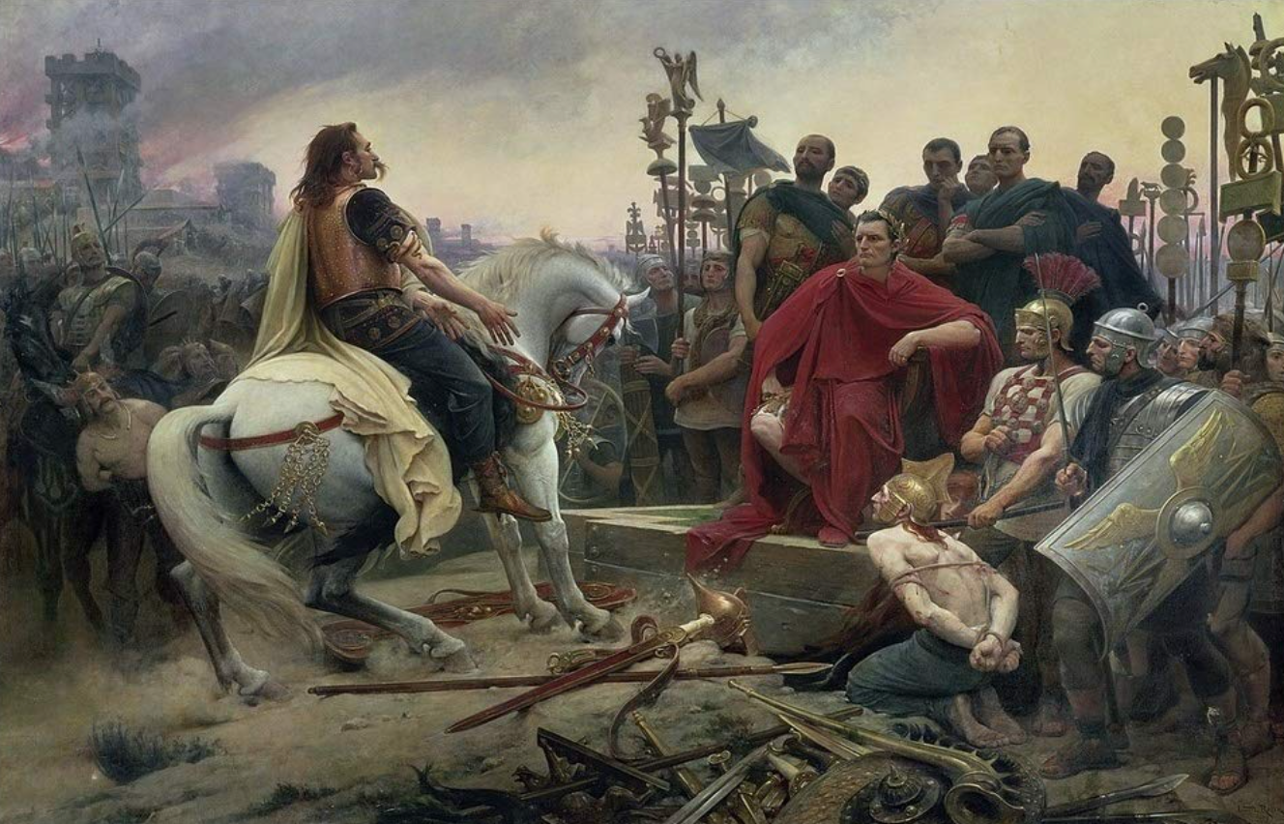
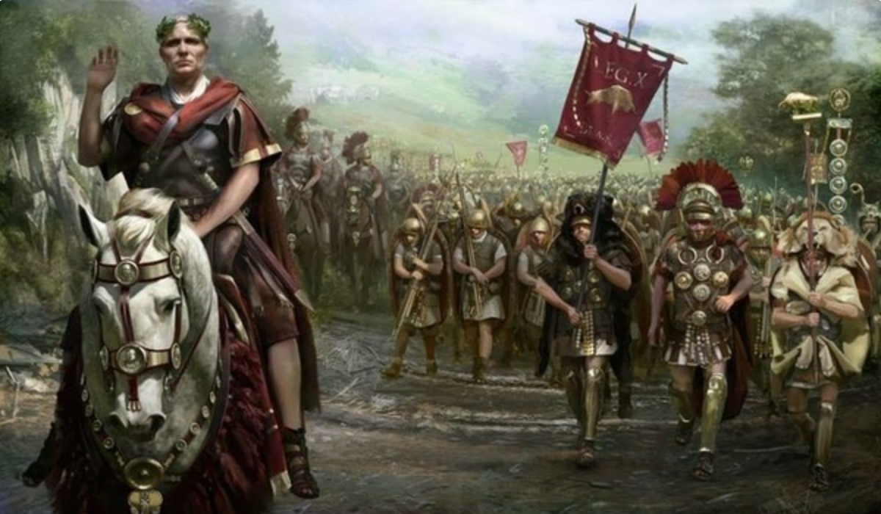
The Rise of Rome II
Roman Institutions are key to the rise of Rome:
Four key factors:
Militarism (on the part of elites competing for authority)
Mobilization (of the citizen mass)
Widely shared benefits (of conquest)
Incorporation (of conquered communities)
Mammoth military and political expansion after -340, and substantial economic, expansion
Slide taken from Melissa Dell

Slide 77
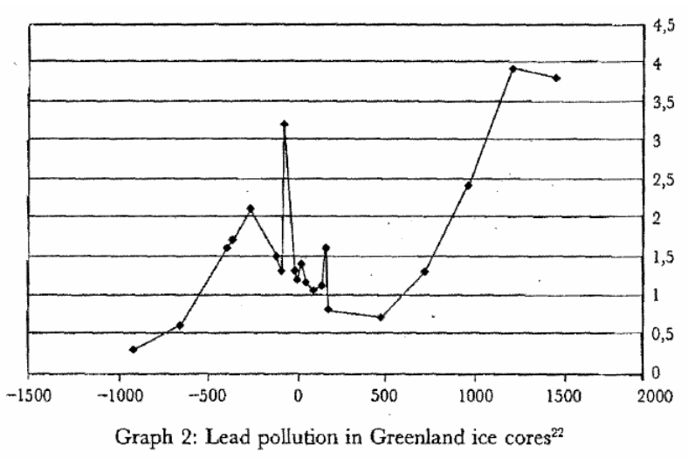
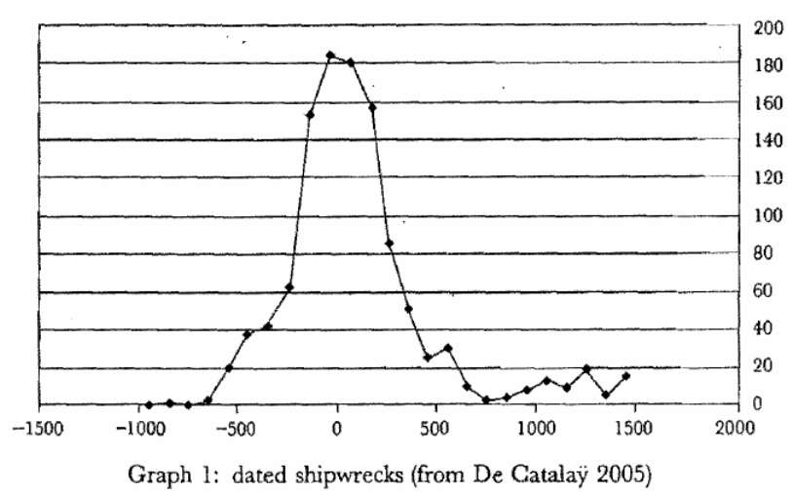
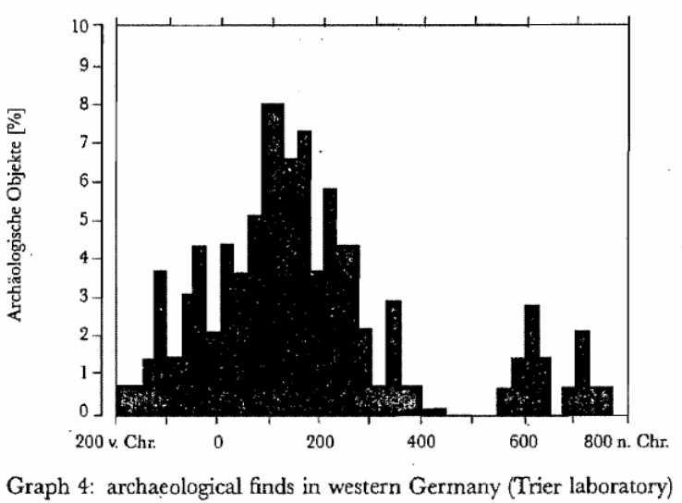
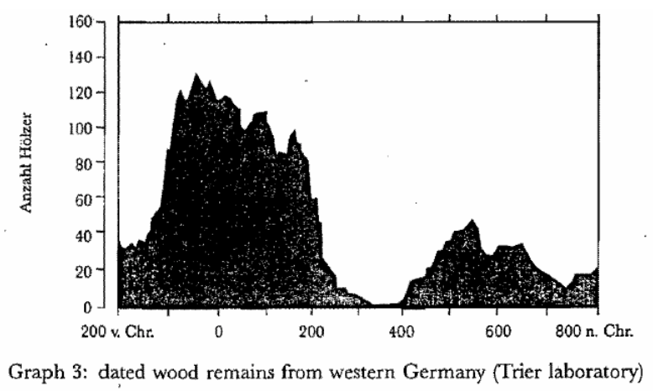
Measuring Roman Efflorescence
There are many interesting ways to track economic expansion:
Shipwrecks indicate trade, but they also track the movement of goods by fiat. For example, the citizens of Rome were kept happy by the free distribution of bread after 58BC. This was later extended to olive oil and even wine. This had to be shipped (mostly from Egypt and North Africa).
The Romans also moved around taxes levied in the provinces and supplied their troops. Some argue that 2/3 of all the ‘trade’ was actually the state moving stuff around.
For Roman citizens, economic institutions were quite good. However, the Italian economy was based on slavery (about 35% of the population of Italy were slaves at the time of the Emperor Augustus). There was little technological change.
Slide taken from Melissa Dell

Slide 78
Review: Pre-Industrial “Efflorescences”
Ideas courtesy of Jack Goldsmith, Daron Acemoglu and James Robinson:
The Malthusian model misses a great deal of the interesting action prior to the Industrial Revolution.
An alternative explanation for why there was no long-run trend in living standards is the theory of ‘efflorescence and decline’
I organize my thoughts about this with the two Malthusian equations, and with their bunch of variables and parameters: h, γ, β, φ, y^{sub}, s, δ, θ, and H that together determine y^{*mal} and L^{*mal}
This is best thought of as a filing system for factors that may be important—given the importance of both capital and labor efficiency, the roles of ideas and of resources in producing labor efficiency, and Malthusian population dynamics, these are the things you should look at

Slide 79
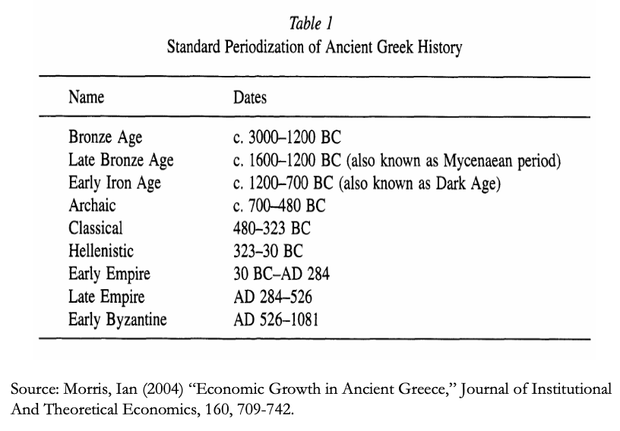
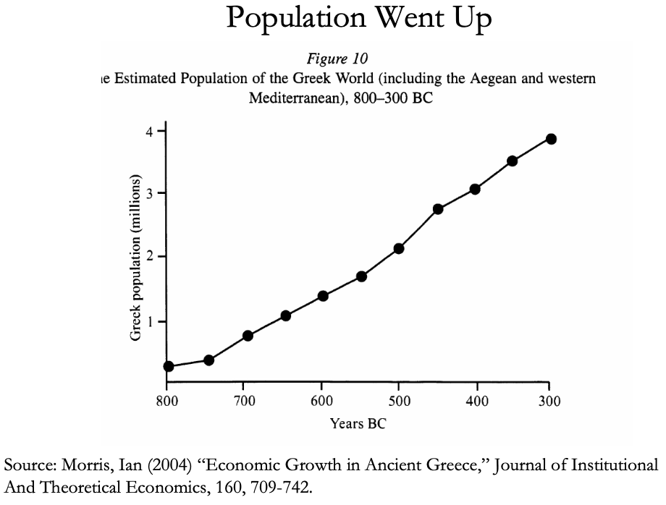
The Classical Greek Efflorescence
Emerging out of the Iron Dark Age of -1200 to -800:
When the Greek city states emerged they did so with functional systems of governance which provided public goods, such as security for trade and investment.
This initiated a period of sustained increases in living standards.
While Ancient Greece did have a period of democracy, it was relative short (less than 200 years) compared to the duration of the polity and most citizens - slaves, poor citizens who couldn’t afford their tax bill, women - could not participate.
Greek institutions (rules according to which the society was organized) tended to be “extractive.” For example, the economy was largely based upon slavery.
Slide taken from Melissa Dell

Slide 80
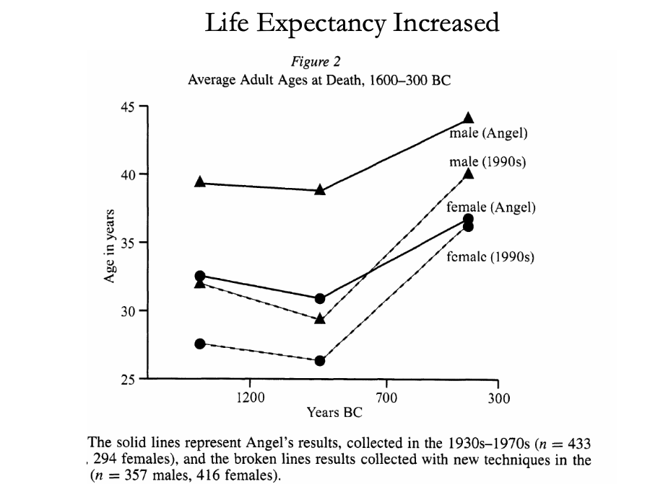
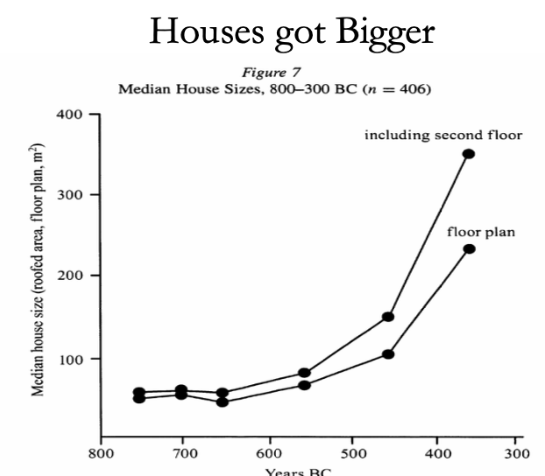
The Classical Greek Efflorescence II
“Developmental” or “Extractive”?
Extractive political institutions concentrate political power in the hands of some group who can use that power to redistribute wealth and income to themselves. This resulting concentration of wealth tends to reinforce the initial set of political institutions.
Roving bandits or stationary bandits?
Acemoglu and Robinson hypothesize that growth was not sustained in ancient societies because their institutions were extractive, and extractive institutions are incompatible with sustaining growth in the long run.
They argue that this is because extracting resources creates conflicts over who will control those resources, and it may also induce rebellion from below.
In either case political instability can bring the government and economy down.
Slide taken from Melissa Dell

Slide 81
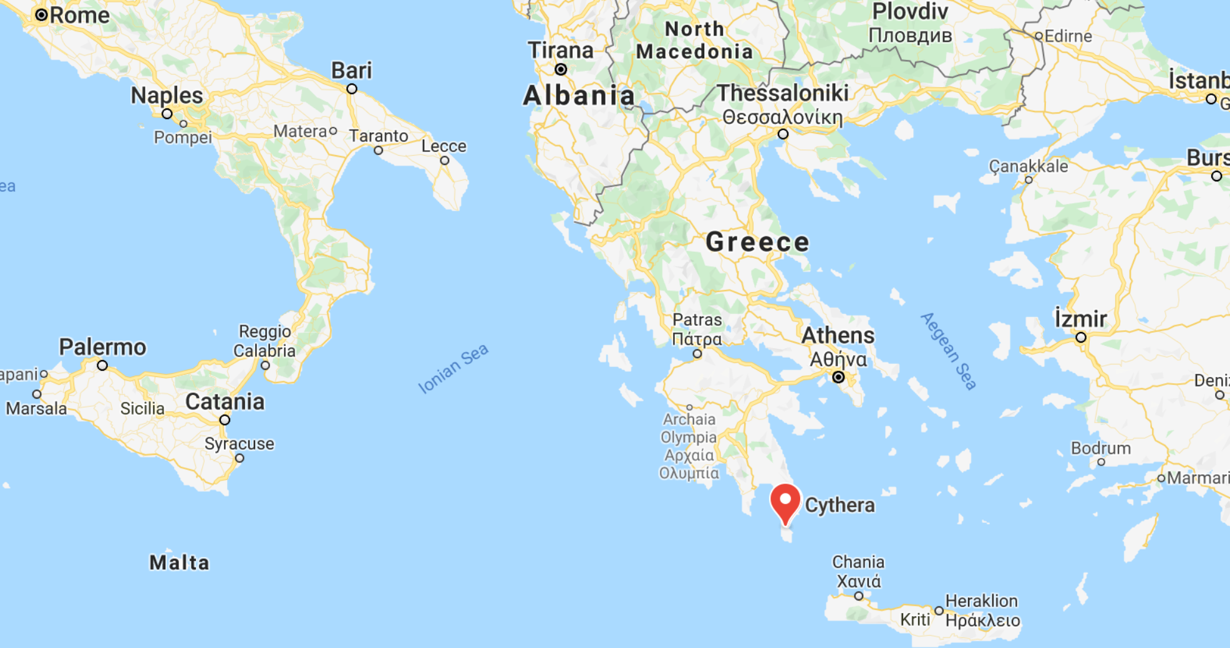

The Anti-Kythera Mechanism
What is this?
Built between -150 and -70. Rhodes13” x 7” x 4“ wooden box
Gears—largest 5” in diameter
Inscriptions
Wikipedia: “37 gear wheels enabling it to follow the movements of the Moon and the Sun through the zodiac, to predict eclipses and even to model the irregular orbit of the Moon, where the Moon's velocity is higher in its perigee than in its apogee. This motion was studied in the 2nd century BC by astronomer Hipparchus of Rhodes, and it is speculated that he may have been consulted in the machine's construction. The knowledge of this technology was lost at some point in antiquity. Similar technological works later appeared in the medieval Byzantine and Islamic worlds, but works with similar complexity did not appear again until the development of mechanical astronomical clocks in Europe in the fourteenth century…”

Slide 82
The Anti-Kythera Mechanism II
What is this?
Brian Resnick: “A main gear would move to represent the calendar year, and would, in turn, move many separate smaller gears to represent the motions of the planets, sun, and moon. So you could set the main gear to the calendar date and get approximations for where those celestial objects would be in the sky on that date…. You, as a user, could input a few simple variables and it would yield a flurry of complicated mathematical calculations.… All the user had to do was enter the main date on one gear, and through a series of subsequent gear turns, the mechanism could calculate things like the angle of the sun crossing the sky. (For some reference, mechanical calculators—which used gear ratios to add and subtract—didn’t arrive in Europe until the 1600s)…”

Slide 83
Cicero (-54): De Re Publica
“With the exception of the dream of Scipio, in the last book, the whole treatise was lost till the year 1822, when the librarian of the Vatican discovered a portion of them among the palimpsests in that library. What he discovered is translated here; but it is in a most imperfect and mutilated state. The form selected was that of a dialogue, in imitation of those of Plato…”
I.XIV:
Then Philus said: “I am not about to bring you anything new, or anything which has been thought over or discovered by me myself. But I recollect that Caius Sulpicius Gallus, who was a man of profound learning, as you are aware, when this same thing was reported to have taken place in his time, while he was staying in the house of Marcus Marcellus, who had been his colleague in the consulship, asked to see a celestial globe which Marcellus’s grandfather had saved after the capture of Syracuse from that magnificent and opulent city, without bringing to his own home any other memorial out of so great a booty; which I had often heard mentioned on account of the great fame of Archimedes; but its appearance, however, did not seem to me particularly striking. For that other is more elegant in form, and more generally known, which was made by the same Archimedes, and deposited by the same Marcellus in the Temple of Virtue at Rome.
“But as soon as Gallus had begun to explain, in a most scientific manner, the principle of this machine, I felt that the Sicilian geometrician must have possessed a genius superior to anything we usually conceive to belong to our nature. For Gallus assured us that that other solid and compact globe was a very ancient invention, and that the first model had been originally made by Thales of Miletus. That afterward Eudoxus of Cnidus, a disciple of Plato, had traced on its surface the stars that appear in the sky, and that many years subsequently, borrowing from Eudoxus this beautiful design and representation, Aratus had illustrated it in his verses, not by any science of astronomy, but by the ornament of poetic description. He added that the figure of the globe, which displayed the motions of the sun and moon, and the five planets, or wandering stars, could not be represented by the primitive solid globe; and that in this the invention of Archimedes was admirable, because he had calculated how a single revolution should maintain unequal and diversified progressions in dissimilar motions.
“In fact, when Gallus moved this globe, we observed that the moon succeeded the sun by as many turns of the wheel in the machine as days in the heavens. From whence it resulted that the progress of the sun was marked as in the heavens, and that the moon touched the point where she is obscured by the earth’s shadow at the instant the sun appears opposite….
Scipio: “I had myself a great affection for this Gallus, and I know that he was very much beloved and esteemed by my father Paulus. I recollect that when I was very young, when my father, as consul, commanded in Macedonia, and we were in the camp, our army was seized with a pious terror, because suddenly, in a clear night, the bright and full moon became eclipsed. And Gallus, who was then our lieutenant, the year before that in which he was elected consul, hesitated not, next morning, to state in the camp that it was no prodigy, and that the phenomenon which had then appeared would always appear at certain periods, when the sun was so placed that he could not affect the moon with his light…”

Slide 84



Review: Class and Conflict: at the End of the Middle Ages, Elsewhere, and Elsewhere
What was “feudalism” and how did it end?
Marc Bloch’s definitions:
A subject peasantry
Widespread use of the service tenement (i.e., the fief) instead of a salary (or of private property plus taxation and then purchase)
The supremacy of a caste of specialized warriors
Ties of obedience and protection which bind man to man
Within the warrior class, these ties assume the distinctive form called vassalage
Fragmentation of authority
Disorder and private war
But also, other forms of association, family, and state surviving…
By the late Middle Ages feudalism was a stable system
Trade and population expanded
What data we have shows the number and size of cities increasing
Slide taken from Melissa Dell

Slide 85
A Four-Cornered Fight
Kings, Lords, Commons, & Peasants:
Class alliances, class power, and class conflict…
Plus ideological legitimations…
Friedrich Engels: “Exceptional periods, however, occur when the warring classes are so nearly equal in forces that the state power, as apparent mediator, acquires for the moment a certain independence in relation to both. This applies to the absolute monarchy of the seventeenth and eighteenth centuries, which balances the nobility and the bourgeoisie against one another; and to the Bonapartism of the First and particularly of the Second French Empire, which played off the proletariat against the bourgeoisie and the bourgeoisie against the proletariat. The latest achievement in this line, in which ruler and ruled look equally comic, is the new German Empire of the Bismarckian nation; here the capitalists and the workers are balanced against one another and both of them fleeced for the benefit of the decayed Prussian cabbage Junker-squires…”
This is not just in exceptional periods…
The relative autonomy of the state is the rule, not the exception…

Slide 86



Review: Malthusian Models and Reality

Slide 87

Eastern Europe and the “Second Serfdom”
The percentage of people killed in Europe was similar across space:
After the plague, landlords in Eastern Europe started to take over large tracts of land and expand their holdings, which were already larger than those in Western Europe.
Towns were weaker and less populous and rather than becoming freer, workers began to see their already existing freedoms encroached on: the Domar hypothesis at work.
This contrasts with western Europe.
Effects became especially pronounced after 1500, when Western Europe began to demand the agricultural goods which the East produced.
Eastern landlords ratcheted up their control over the labor force to expand their production.
Mecklenberg: in 1500, peasants owed only a few days service a year; by 1600 this was three days/week; children had to work for the lord for free for several years.
In Hungary, landlords legislated one day a week of unpaid labor services for each worker. In 1550 this was raised to 2 days per week. By the end of the century it was 3 days. Serfs subject to these rules made up 90% of the rural population.
What was it that allowed the Spanish settlers in Mexico to keep wages so low, when in England after the Black Death the state had been incapable of enforcing the Statue of Laborers and stopping wages from rising?
William the Conqueror rewarded his army by providing them with parceled landholdings to prevent them from becoming powerful regional warlords (save for the “marcher lords” along the Scottish and Welsh borders).
Many landholders in close proximity created intense competitive pressures for labor in the wake of the Black Death.
Slide taken from Melissa Dell

Slide 88

Is Malthus Right? II
At the macro level, yes; but there are lots of interesting meso- and small-scale puzzles:
In addition, measures of good government, such as proxies for constraints on the executive, are correlated with urbanization in this period.
For example, DeLong and Shleifer (1993) showed there was a strong correlation between form of government and urbanization in the pre-modern world
Charles Wilson (1967): Trade, Society, and the State: "The two areas which in 1500 represented the richest and most advanced concentrations of trade, industry and wealth were the quadrilateral formed by the Italian cities Milan, Venice, Florence and Genoa; and the strip of the Netherlands that ran from Ypres north-east past Ghent and Bruges up to Antwerp. It was not merely coincidence that these were the areas where the tradesmen of the cities had been most successful in emancipating themselves from feudal interference and in keeping at bay the newer threat of more centralized political control offered by the new monarchies. In the fleeting intervals between the storms of politics and war, men here glimpsed the material advance that was possible when tradesmen were left in peace unflattered by the attentions of strategists who regarded their activities as the sinews of war…”
Slide taken from Melissa Dell

Slide 89
Malthus: Summing Up
On the broadest scale only:
The simple Malthusian model may indeed capture some realities.
If labor markets are competitive, population growth may indeed induce a decline in wages.
Or if there is a fixed amount of land and few opportunities for labor intensive cultivation systems, a population increase may lead to a decline in output per worker.
However, the reality is typically much more messy.
How wages respond to changes in income will depend on institutions.
Thus the overwhelming likelihood that institutional or cultural factors also shaped pre-modern growth
It was not simply being dictated by the Malthusian relationship between births, deaths, and income.
Slide taken from Melissa Dell

Slide 90

Review: “Subsistence”

Slide 91



“Bare-Bones”
From Clark & Allen:
"Manual workers”—70% of median, 50% of average income
In 1800: the English population in 1800 is a very rich pre-industrial population
70% of spending spent on food
30-40% grains
20% meat and dairy
“Bare-bones” subsistence
Cities: Malthus rules, but it takes centuries—and other things can and do happen

Slide 92




Review: Determinants of Technological and Organizational Progress
How do we make sense of the fact that technological and organizational progress was so slow back then and is so (relatively) rapid now?
Two heads are (almost) better than one
But that does not quite work
Add in additional drag from first picking low-hanging fruit
What causes the increase in Lstem?
What institutions make it profitable for nstem to be higher?
Plus:
Learning by doing
Productivity through embodiment
Technology transfer through contact

Slide 93
Review: Solow-Malthus Model Basics
How do we make sense of the fact that people were ingenious and inventive back before 1500, and yet standards of living did not increase?
Although population did increase—slowly
Other parts of the model
Balanced-growth equilibrium
Convergence to equilibrium
Lecture notes: <https://nbviewer.jupyter.org/github/braddelong/long-form-drafts/blob/master/solow-model-5-pre-industrial.ipynb>
datahub: <http://datahub.berkeley.edu/user-redirect/interact?account=braddelong&repo=long-form-drafts&branch=master&path=solow-model-5-pre-industrial.ipynb>

Slide 94
Understanding the Solow-Malthus Equilibrium: Population and Labor Force
Notes:

Slide 95
Understanding the Solow-Mathus Equilibrium: Prosperity
Notes:

Slide 96

Steady-State and Along the Transition Path
The fall of an empire:
<https://nbviewer.jupyter.org/github/braddelong/LS2019/blob/master/2019-10-14-Ancient_Economies.ipynb>
A decline in inequality, taste for luxuries, and taste for urban living: Δφ = -0.25
A decline in law-and-order that produces a sharp fall in the savings rate: Δs = -0.10

Slide 97





Review: Solow Model Basics
Lecture Notes: <https://www.bradford-delong.com/2020/01/lecture-notes-the-solow-growth-model-the-history-of-economic-growth-econ-135.html>

Slide 98

Solving the Model

Slide 99

Along the Balanced-Growth Path
Everything except κ—which is constant—grows at a constant proportional rate: either n, or g, or n+g;
Labor force L grows at n
Income per worker y and the efficiency of labor E grow at g
Total income Y and the capital stock K grow at n+g

Slide 100
Review: Long-Run Patterns: Global h, g, & n

Slide 101

Long-Run Patterns: “Western” h, g & n
Where does the “ρ” come from?
“Ghost acreage”—conquest and resource utilization (sugar islands, timberlands, cottonlands, etc.)
Cultural expansion—Australia, Canada, New Zealand, & U.S.; Spain & Italy & Scandinavia; plus Japan, Korea, Taiwan, Hong Kong, & Singapore

Slide 102

One Figure: A Great Divergence
10:20
From 1800 to 2018:
The dots start with a 3-1 spread in incomes and a 10-year spread in life expectancy.
All the arrows go up.
Some arrows—mostly those already to the right—go right fast.
Other arrows go right slowly.

Slide 103

China and India and America, 1800-1975
From 1800 to 1975:
Measured living standards and productivity levels improve fourteen-fold in the United States…
…& less than 30% in China & India…
…in spite of economic, transport, and cultural globalization…
This is crazy!
A “great divergence”
Not only were China & India relatively poor in 1800, they fell further behind thereafter

Slide 104

China and India and America, 1975–2018
From 1975-2018:
Measured living standards and productivity levels…
…54.9/25.9 = 2.12 in America…
…16.0/0.9 = 17.8 in China…
…6.9/1.2 = 5.8 in India…

Slide 105

Review: Allen: Reform and Democracy
Robert Allen (2017): The Industrial Revolution: A Very Short Introduction <https://delong.typepad.com/files/allen-industrial.pdf>, chs. 3, 5-6:
Enlightenment, literacy, pamphlets, The Rights of Man (sells 1 million copies), & the French Revolution
60,000-strong Manchester demonstration in 1819: eleven killed: “Peterloo”
“Reform that we may preserve”: 1832 Reform Bill
Virtual representation
Divide the reformers
1833: Factory Act—9-hour day for children under 12
1834: New Poor Law—workhouses

Slide 106

Allen: Reform and Democracy II
Robert Allen (2017): The Industrial Revolution: A Very Short Introduction <https://delong.typepad.com/files/allen-industrial.pdf>, chs. 3, 5-6:
1833: Factory Act—9-hour day for children under 12
1834: New Poor Law—workhouses
1838: People’s Charter
1846: Corn Law Repeal
The “condition of England”
John Stuart Mill (1848 and 1871): “It is questionable if all the mechanical inventions yet made have lightened the day's toil of any human being. They have enabled a greater population to live the same life of drudgery and imprisonment…”
1846-67: Real wage stagnation ends: average consumption per head in working class families rose by 42 per cent…

Slide 107
The People’s Charter
The People's Charter called for six reforms to make the political system more democratic:
A vote for every man twenty-one years of age, of sound mind, and not undergoing punishment for a crime.
The secret ballot to protect the elector in the exercise of his vote.
No property qualification for Members of Parliament in order to allow the constituencies to return the man of their choice.
Payment of Members, enabling tradesmen, working men, or other persons of modest means to leave or interrupt their livelihood to attend to the interests of the nation.
Equal constituencies, securing the same amount of representation for the same number of electors, instead of allowing less populous constituencies to have as much or more weight than larger ones.
Annual Parliamentary elections, thus presenting the most effectual check to bribery and intimidation, since no purse could buy a constituency under a system of universal manhood suffrage in each twelve-month period

Slide 108
Greg Clark Being Contrarian
There were lots of technological “revolutions” before the Industrial Revolution
But they all petered out because of low price-elasticity of demand
Coal-steam-cotton-machinery-textiles-rails were different
But even that was reaching limits to growth by 1870 or so…
The classic British Industrial Revolution more a comparative-advantage concentration of global manufacturing than true modern economic growth…

Slide 109
Karl Marx (1867): The Key is “Capitalism”—Market Economy Plus…
Karl Marx (1867), "The Secret of Primitive Capital Accumulation," Capital, Vol. 1, Part VIII, Chapters 26-32 http://tinyurl.com/dl20090112k
“We have seen how money is changed into capital; how through capital surplus-value is made, and from surplus-value more capital. But the accumulation of capital presupposes surplus-value; surplus-value presupposes capitalistic production; capitalistic production presupposes the pre-existence of considerable masses of capital and of labour power in the hands of producers of commodities. The whole movement, therefore, seems to turn in a vicious circle, out of which we can only get by supposing a primitive accumulation (previous accumulation of Adam Smith) preceding capitalistic accumulation; an accumulation not the result of the capitalistic mode of production, but its starting point…”
“The immediate producer, the labourer, could only dispose of his own person after he had ceased to be attached to the soil… the slave, serf, or bondsman of another. To become a free seller of labour power… he must further have escaped from the regime of the guilds…. The historical movement which changes the producers into wage-workers… their emancipation from serfdom and from the fetters of the guilds… alone exists for our bourgeois historians…”
“But… these new freedmen… [were also] robbed of all their own means of production, and of all the guarantees of existence afforded by the old feudal arrangements. And the history of this, their expropriation, is written in the annals of mankind in letters of blood and fire…”
Workers must work for wages…
Capitalists must invest and accumulate…

Slide 110

Karl Marx & Friedrich Engels
Paean to the Bourgeoisie:
“The bourgeoisie cannot exist without constantly revolutionising the instruments of production, and thereby the relations of production, and with them the whole relations of society. Conservation of the old modes of production in unaltered form, was, on the contrary, the first condition of existence for all earlier industrial classes…”
9:50-9:55

Slide 111
Paean to the Bourgeosie II
Revolutionary Change and Unveiling:
“Constant revolutionising of production,
“uninterrupted disturbance of all social conditions,
“everlasting uncertainty and agitation distinguish the bourgeois epoch from all earlier ones.
“All fixed, fast-frozen relations, with their train of ancient and venerable prejudices and opinions, are swept away,
“all new-formed ones become antiquated before they can ossify.
“All that is solid melts into air,
“all that is holy is profaned, and
“man is at last compelled to face with sober senses his real conditions of life, and his relations with his kind…
9:50-9:55

Slide 112
Paean to the Bourgeosie III
Globalization:
“The bourgeoisie has subjected the country to the rule of the towns.
“It has created enormous cities,
“has greatly increased the urban population as compared with the rural, and
“has thus rescued a considerable part of the population from the idiocy of rural life.
“Just as it has made the country dependent on the towns,
“so it has made barbarian and semi-barbarian countries dependent on the civilised ones,
“nations of peasants on nations of bourgeois,
“the East on the West…
9:50-9:55

Slide 113
Karl Marx: Capital: Part VII: The Accumulation of Capital
This is where the book starts to sing—to me. What I got out of chapter 23:
To quote from the Communist Manifesto, “the executive of the modern state is a committee for managing the affairs of the business class.” Wealth speaks loudly, and influences the government to arrange things for the convenience of wealth—to keep wages low, and workers available. Marx quotes a protest from The Times of London against the demands of capital in 1863:
“Mr. Edmund Potter is so impressed with the exceptional and supreme importance of the cotton masters that, in order to preserve this class and perpetuate their profession, he would keep half a million of the labouring class confined in a great moral workhouse against their will.… We must confess that we do not think it ‘worth while,’ or even possible, to keep the human machinery in order—that is to shut it up and keep it oiled till it is wanted. Human machinery will rust under inaction, oil and rub it as you may. Moreover, the human machinery will, as we have just seen, get the steam up of its own accord, and burst or run amuck…”

Slide 114
“Alienation”
Capital is made up of what the workers produce:
But what the workers produce then does not advance their interests or make them happy…
Instead, what the workers have produced somehow escapes from human control…
It then imposes itself on people, and bosses them around…
Note: it’s not that capital transfers human freedom and flourishing from the workers to the capitalists:
The capitalists have to act like capitalists—push wages down, speedup the line, and reinvest their profits
If they don’t? They become uncompetitive go bankrupt, and become workers
This is Marx’s theory of “alienation”—what one has made then remakes you
“Here in America, everyone watches television. In Soviet Russia, television watches you!”

Slide 115
Accumulate, Accumulate!
A capitalist market economy is driven to invest and reinvest to boost the economy’s capital stock:
“Accumulation for the sake of accumulation, production for the sake of production: this was the formula in which classical economics expressed the historical mission of the bourgeoisie in the period of its domination. Not for one instant did it deceive itself over the nature of wealth’s birth-pangs. But what use is it to lament a historical necessity? If, in the eyes of classical economics, the proletarian is merely a machine for the production of surplus-value, the capitalist too is merely a machine for the transformation of this surplus-value into surplus capital…”
A capitalist market economy is driven to become more capital intensive:
“The law of the progressive growth of the constant part of capital in comparison with the variable part is confirmed at every step … by the comparative analysis of the prices of commodities, whether we compare different economic epochs or different nations in the same epoch. The relative magnitude of the part of the price which represents the value of the means of production, or the constant part of the capital, is in direct proportion to the progress of accumulation, whereas the relative magnitude of the other part of the price, which represents the variable part of the capital, or the payment made for labour, is in inverse proportion to the progress of accumulation…”

Slide 116
Invention and Innovation Deskill Workers, and Put Downward Pressure on the Demand for Labor
Marx believes that machinery is not a complement to but a substitute for labor:
“Since the demand for labour is determined not by the extent of the total capital but by its variable constituent alone, that demand falls progressively with the growth of the total capital, instead of rising in proportion to it, as was previously assumed….
“[Capital] produces indeed in direct relation with its own energy and extent, a relatively redundant working population, i.e. a population which is superfluous to capital’s average requirements for its own valorization, and is therefore a surplus population….
“The working population therefore produces both the accumulation of capital and the means by which it is itself made relatively superfluous…”

Slide 117
The “Industrial Reserve Army” of the Non-Employed
For Marx, it is inconceivable that there might be a permanent, durable increase in the average wage level:
“The industrial reserve army, during the periods of stagnation and average prosperity, weighs down the active army of workers; during the periods of over-production and feverish activity, it puts a curb on their pretensions. The relative surplus population is therefore the background against which the law of the demand and supply of labour does its work. It confines the field of action of this law to the limits absolutely convenient to capital’s drive to exploit and dominate the workers…”
Note that the century and a half after Marx wrote saw wages multiply tenfold in the Global North world economy core.
There is something wrong with the argument…
November 12, 2019

Slide 118
Forest of Outstretched Arms…
In fact, for Marx it is inconceivable the average wage level will stay above bare subsistence:
Karl Marx:
“The most diverse machines are now applied to the manufacture of the machines themselves…. The labourers employed in machine factories can but play the role of very stupid machines alongside of the highly ingenious machines…. To sum up: the more productive capital grows, the more it extends the division of labour and the application of machinery; the more the division of labour and the application of machinery extend, the more does competition extend among the workers, the more do their wages shrink together…. A mass of small business men and of people living upon the interest of their capitals is precipitated into the ranks of the working class…. Thus the forest of outstretched arms, begging for work, grows ever thicker, while the arms themselves grow every leaner…”
Note that the century and a half after Marx wrote saw wages multiply tenfold in the Global North world economy core.
There is something wrong with the argument…

Slide 119
Karl Marx: Summing Up
Marx and His Vision:
Marx’s vision: utopia is now, thanks to the epoch of the bourgeoisie, within our grasp
But the bourgeoisie that has performed this historic task is now the major obstacle to utopia
The Marxist movement: really-existing-socialism 1917-1991 not the brightest light on humanity’s tree of good ideas…
Marx’s three-stage trajectory: philosopher/analyst/economist
Marx’s three intellectual faces: prophet, political analyst, economist:
Marx the prophet… unhelpful for this world (New Jerusalem)
Marx the organizer and analyst… largely wrong (capitalism stripping away the veil of illusion; ruling class will never moderate the system; factory and workers solidarity as the future)
Marx the economist… wrong and right

Slide 120
Karl Marx the Economist
The Good:
Three:
Fever-fits of financial crisis and business cycle
Among the first to understand how transformative the Industrial Revolution would be
Very insightful about the history of industrialization
Marx’s genius responsible for the good
The Bad:
Also three:
Capital always a substitute for labor
Markets as always a source of mystification and oppression
Market economy cannot deliver a good division of income
Hegel, Manchester, the (inherited from Ricardo) Labor Theory of Value, and stubbornness responsible for the bad

Slide 121
Sources of Marx’s Misconceptions: Hegel
Here is Engels trying to make Marx’s coquetting with Hegel’s modes of expression clear:
“Marx says: ‘It is the negation of negation. This re-establishes individual property, but on the basis of the acquisitions of the capitalist era, i.e., on co-operation of free workers and their possession in common of the land and of the means of production produced by labour…’
The state of things brought about by the expropriation of the expropriators is therefore characterised as the re-establishment of individual property, but on the basis of the social ownership of the land and of the means of production produced by labour itself.
To anyone who understands plain talk this means that social ownership extends to the land and the other means of production, and individual ownership to the products, that is, the articles of consumption.
And in order to make the matter comprehensible even to children of six, Marx assumes on page 56 ‘a community of free individuals, carrying on their work with the means of production in common, in which the labour-power of all the different individuals is consciously applied as the combined labour-power of the community’, that is, a society organised on a socialist basis; and
he continues: ‘The total product of our community is a social product. One portion serves as fresh means of production and remains social. But another portion is consumed by the members as means of subsistence. A distribution of this portion amongst them is consequently necessary’.
And surely that is clear enough even for Herr Dühring, in spite of his having Hegel on his brain…”
This does not help

Slide 122
Sources of Marx’s Misconceptions
Manchester:
Manchester, especially in the aftermath of the Irish Potato Famine, an unusual outlier—not a model for the future…
The Labor Theory of Value:
It just does not work…
Stubbornness:
What do you do when the world surprises you?
Do you double down, and turn all the ingenuity of your brain to figuring out reasons why what you had thought to be true and what is apparently false is true after all?
Or do you mark your beliefs to market?

Slide 123
A Paragraph to Note
How should we read this paragraph?:
“The law... of surplus-value produced... clearly contradicts all experience based on appearance.... A cotton spinner, who... employs... little variable capital, does not, on account of this, pocket less profit or surplus-value than a baker... [with] much variable... capital. For the solution of this apparent contradiction, many intermediate terms are as yet wanted, as from the standpoint of elementary algebra many intermediate terms are wanted to understand that 0/0 may represent an actual magnitude.... It will be seen later how the school of Ricardo has come to grief over this stumbling block. Vulgar economy which, indeed, ‘has really learnt nothing’, here as everywhere sticks to appearances in opposition to the law which regulates and explains them. In opposition to Spinoza, it believes that “ignorance is a sufficient reason”...
That equal capitals deployed over equal times with equal degrees of risk yield equal profits independent of how many workers their deployment sets to work should have made Marx rethink.
But it did not: instead it made him add epicycle upon epicycle…

Slide 124
David Landes: Why Northwest Europe? Why Not China?
China had two chances:
First, to generate a continuing, self-sustaining process of scientific and technological advance on the basis of its indigenous traditions and achievements
Second, to learn from European science and technology once the foreign “barbarians” entered the Chi- nese domain in the sixteenth century.
The first failure has elicited much scholarly inquiry and analysis. And yet it remains an abiding mystery.
Chinese priority:
Textiles: a power-driven spinning machine in the thirteenth century, some 500 years before the England of the Industrial Revolution knew water frames and mules
Iron: China early learned to use coal and probably coke (as against charcoal) in blast furnaces for smelting iron and were turning out perhaps as many as 125,000 tons of pig iron by the later eleventh
Other industries: the wheelbarrow, the stirrup, the rigid horse collar (to prevent choking), the compass, paper, printing, gunpowder, porcelain
The mystery lies in the failure of China to realize the potential of some of the most important of these inventions….
Chinese industrial history offers a number of examples of technological regression and oblivion:
The machine to spin hemp was never adapted to the manufacture of cotton
Cotton spinning was never mechanized
Coal/coke smelting was allowed to fall into disuse, along with the iron industry
9:55-10:10

Slide 125
Landes: Conventional Explanations (of European Success) Inadequate
But almost every element usually regarded by historians as a major contributory cause to the Industrial Revolution in north-western Europe was also present in China:
A revolution in the relations between social classes, at least in the countryside
Only Galilean-Newtonian science was missing; but in the short run this was not important.
Had the Chinese possessed, or developed, the seventeenth-century European mania for tinkering and improving, they could easily have made an efficient spinning machine out of the primitive model described by Wang Chen.
A steam engine would have been more difficult; but it should not have posed insuperable difficulties to a people who had been building double-acting piston flame-throwers in the Sung dynasty.
The crucial point is that nobody tried.
In most fields, agriculture being the chief exception, Chinese technology stopped progressing well before the point at which a lack of scientific knowledge had become a serious obstacle
9:55-10:10

Slide 126
Landes: Sinologist Explanations (of China’s Failure)
Partial explanations only:
First, China lacked a free market and institutionalized property rights.
The Chinese state was always stepping in to interfere with private enterprise—to take over certain activities, to prohibit and inhibit others, to manipulate prices, to exact bribes:
Motivated by a desire to reserve labor to agriculture
To control important resources (salt and iron, for example)
By an appetite for revenue (the story of the goose that laid the golden eggs is a leitmotif of Chinese history);
By fear and disapproval of self-enrichment, except by officials, giving rise in turn to abundant corruption and rent-seeking
By a distaste for maritime trade… [seen] as a diversion from imperial concerns, as a divisive force and source of income inequality in the ecumenical empire, and worse yet, as an invitation to exit.
This state intervention and interference encountered evasion and resistance; indeed, the very needs of state compelled a certain tolerance for disobedience.
Still, the goal, the aim, the ideal was the ineffable stillness of immobility.
The Hongwu (“Vast Martial”) emperor… He wanted rather to immobilize the realm. People were to stay put and move only with the permission of the state—at home and abroad. People who went outside China without per- mission were liable to execution on their return. The Ming code of core laws also sought to block social mobility, with severe penalties for those jumping professional and occupational barriers.
The reason the Chinese did not develop based on their scientific knowledge is that no one was trying. Why try?
In all this, the contrast with Europe was marked.
9:55-10:10

Slide 127
Landes: Sinologist Explanations (of China’s Failure) II
Elvin (1973, pp. 224–225) captures some of this:
It was the great size of the Chinese Empire which made the adoption of the policies of the Ming emperors possible.
In a Chinese subcontinent made up of smaller independent states, like those of the Five Dynasties [907-960 C.E.] or the Ten Kingdoms, no government could have afforded to close itself off. International economic interdependence (as that between regions would have become) would have removed this option; and the need for diplomatic and military alliances, and revenue from foreign trade, would have made isolationism undesirable.
With smaller states, there might also have been, as there was in north-western Europe in early modern times, a closer conscious identification of the governed with their countries and rulers.
Why this peculiarly European joy in discovery? This pleasure in the new and better? This cultivation of invention—or what some have called “the invention of invention”?
Different scholars have suggested a variety of reasons, typically related to religious values;
The Judaeo-Christian respect for manual labor, summed up in a number of biblical injunctions. One example will suffice: when God warns Noah of the coming flood and tells him he will be saved, it is not God who saves him. “Build thee an ark of gopher wood,” says the Lord
The Judaeo-Christian subordination of nature to man—a sharp departure from widespread animistic beliefs and practices that saw something of the divine in every tree and stream (hence the naiads and dryads).
The Judaeo-Christian sense of linear time. Other societies thought of time as cyclical, returning to earlier stages and starting over again.
In the last analysis, however, I would stress the role of the market:
Enterprise was free in Europe
Innovation worked and paid,
Rulers and vested interests were narrowly constrained in what they could do to prevent or discourage innovation
Success bred imitation and emulation
9:55-10:10

Slide 128

Review: Globalization Advances and Retreats
In historical perspective:
Early modern European navies and trading fleets
How did they shape industrial development?
It is agreed:
catastrophes for west Africa
catastrophes for the Amerindians
catastrophe (long term) for Moghul and other Indian elites that did not ally with the British.
But how much did pre-industrial trade and plunder affect European development? That is not so clear.
A key link: sugar
A key link: cotton
George Washington in the 1790s: 1/4 of wealth upon your death,
For Jefferson Davis it wasn’t his land but rather his slaves that were three-quarters of his wealth
And so the U.S. Civil War of 1861-5 came.
Early-nineteenth century cotton showed what late-eighteenth century sugar had prefigured:
Long-distance transoceanic trade could matter not just for the consumption pattern of an elite but for an economy, a polity, and a society as a whole.
This process was kicked up a notch, into much higher gear, come 1870.
2:30
Notes:
The extent to which the navies and trading fleets of the great European sea-borne empires of the sixteenth, seventeenth, and eighteenth centuries shaped the industrial development of western Europe has always been one of the most fiercely-debated and unsettled topics in economic history.
That European expansion in the sixteenth, seventeenth, and eighteenth centuries were catastrophes for the regions of west Africa that were the sources of the slave trade; for the Amerindians of the Caribbean; for the Aztecs, Incas, the mound-builders of the Mississippi valley; and for the princes of Bengal and others who found themselves competing with the British East India Company in the succession wars over the spoils of India’s Moghul Empire—that is not in dispute.
But how much did pre-industrial trade and plunder affect European development? That is not so clear.
What is clear is that even at the end of the eighteenth and the first half of the nineteenth century trade not in luxuries but in staples had begun to profundly shape history.
Without the appetite of British and New England factories for cotton and the power to ship ginned cotton to them cheaply, the slaves of the American south in 1860 would have been what they were for George Washington in the 1790s: a quarter of your wealth that you were willing to free, at least upon your death, because it was the right thing to do. By contrast, for Jefferson Davis it wasn’t his land but rather his slaves that were three-quarters of his wealth—and so the U.S. Civil War of 1861-5 came.
Early-nineteenth century cotton showed what late-eighteenth century sugar had prefigured: for the first time long-distance transoceanic trade could matter not just for the consumption pattern of an elite but for an economy, a polity, and a society as a whole. Cotton and sugar meant that European agriculture did not have to grow nearly as much flax or raise as much wool or produce as many calories, and so provided an extra edge to the British economy: as if there was perhaps one additional ghost worker who did not have to be fed or paid alongside every ten.
But this process was kicked up a notch, into much higher gear, come 1870.

Slide 129
Export Share Doubling
World trade as a proportion of production:
What was it?
It was perhaps 1.5% in 1500
Rising to perhaps 3% by 1700
By 1850, about 4%.
In 1880 it was 11%
By 1913 17%.
(Today it is 30%.)
Between 1870 and 1913 exports as a share of national product doubled in India and in what was to become Indonesia
And more than tripled in China.
And in Japan—forced out of two and a half centuries of Tokugawa isolationism by U.S. gunboats—exports rose from practically zero to 7 percent of national product in only two pre-World War I generations.
0:45
Notes:
Between 1870 and 1913 exports as a share of national product doubled in India and in what was to become Indonesia, and more than tripled in China. And in Japan—forced out of two and a half centuries of Tokugawa isolationism by U.S. gunboats—exports rose from practically zero to 7 percent of national product in only two pre-World War I generations. International trade as a proportion of total world production—what was it? It was perhaps 1.5% in 1500, rising to perhaps 3% by 1700 and, by 1850, about 4%. In 1880 it was 11%, and by 1913 17%. (Today it is 30%.)

Slide 130
Three Aspects of Globalization Took Hold Around 1870
Goods transport, communication, and human migration
You tell the story of European economies 1500-1800 with only occasional glances further abroad? Many do:
But after 1870… for good and for ill, the happenings on one continent could not but substantially change people’s opportunities and constraints on others:
In 1800-1850 cost of moving flour in a boat across the Atlantic for 3000 miles was fully half as much as the cost of purchasing the flour delivered in New York
By 1850-1875 the average premium was down to 20% or so
And by 1900? Less than 5%:
1:45
Notes:
Three features of globalization took hold around 1870:
1. The globalization of transport, in the form of the iron-hulled screw-propellered ocean-going steamship linked to the railroad network—and subsequent follow-on developments.
2. The globalization of communication, in the form of the global submarine telegraph network linked to landlines—and subsequent follow-on developments.
3. The lack of barriers. The most important lack, perhaps, was open borders for migration—with the very important caveat that the poorest from China, India, and elsewhere were not allowed into the temperate settlements: those were reserved for Europeans (and, sometimes, Middle Easterners). One in fourteen humans changed their continent between 1870-1914. But also important in were the lack of government blockages to trade and investment and communication. People could and did move. And finance, machines, railroads, steamships, and the telegraph nerves of production and distribution networks could follow, chasing abundant natural physical and biological resources.
You tell the story of European economies 1500-1800 with only occasional glances further abroad? Many do:
But after 1870… for good and for ill, the happenings on one continent could not but substantially change people’s opportunities and constraints on others:
In 1800-1850 cost of moving flour in a boat across the Atlantic for 3000 miles was fully half as much as the cost of purchasing the flour delivered in New York:
By 1850-1875 the average premium was down to 20% or so:
And by 1900? Less than 5%:

Slide 131
A Much Smaller World
The possibility—nay the inevitability—of making the world a single economic system
The world economy was, for the first time, a single economic system
The earnings of a rubber tapper in Brazil would be powerfully influenced by things happening continents away
The economic growth and demand for rubber in North America and in western Europe
The success of the British imperial project in Malaya,
The “success” of the Belgian imperial project in the Congo
ResourceS were extracted
New products were produced and brought to market
Old products were brought to new places:
Oil palms and nuts to west Africa,
Rubber to Malaysia
Coffee to Brazil and central America
Wheat and sheep to Australia
Many many more.
And it was the absence of barriers—the ideology of free trade—that turned the possibility of an integrated world economic system into a reality
1:15
Notes:
The iron-hulled steamship, the submarine telegraph cable, and the gunboat created not a fact but a much smaller world. It created the possibility of making the world economy, for the first time, a single economic system: the earnings of a rubber tapper in Brazil would be powerfully influenced by things happening continents away—by the economic growth and demand for rubber in North America and in western Europe and by the success of the British imperial project in Malaya, as well as the “success” of the Belgian imperial project in the Congo, to name four. Resource were extracted, new products were produced and brought to market, and old products were brought to new places: oil palms and nuts to west Africa, rubber to Malaysia, coffee to Brazil and central America, wheat and sheep to Australia, and many many more. which transport, communication, and imperial rule could cover quickly indeed.
And the absence of barriers turned the possibility of an integrated world economic system into a reality.

Slide 132
Railroads
Let’s dunk on Henry David Thoreau!”
‘To make a railroad round the world.... Men have an indistinct notion that if they keep up this activity of joint stocks and spades long enough all will at length ride somewhere in next to no time and for nothing, but though a crowd rushes to the depot and the conductor shouts “All aboard!” when the smoke is blown away and the vapor condensed, it will be perceived that a few are riding, but the rest are run over—-and it will be called, and will be, “a melancholy accident”…’
My ancestors had a very different view.
The old rule-of-thumb before the railroad was that you simply could not transport agricultural goods more than 100 miles by land
By that time what the horses or oxen would have eaten was as much as they could pull.
For Thoreau the fact that it took him a day to walk or ride into Boston was a benefit—part of living deliberately.
But that one would seek to live deliberately above all else is the point of view of a rich guy
Or at least of a guy without a family to care for.
The railroad made a big difference for all those who did not live near navigable waterways.
But the true revolution in transportation—the one that mattered for nearly everyone—came not in the 1830s with the railroad, but rather later, with the iron-hulled ocean-going coal-fired steamship.
2:00
Notes:
The metallurgy to cheaply make the rails and the engines of the railroad had made transport over land wherever the rails ran as cheap as travel up navigable watercourses or across the oceans had every been, and made it faster.
The mid-nineteenth century Massachusetts transcendentalist author and activist Henry David Thoreau’s response to the railroad was: “get off my lawn!”:
To make a railroad round the world.... Men have an indistinct notion that if they keep up this activity of joint stocks and spades long enough all will at length ride somewhere in next to no time and for nothing, but though a crowd rushes to the depot and the conductor shouts “All aboard!” when the smoke is blown away and the vapor condensed, it will be perceived that a few are riding, but the rest are run over—-and it will be called, and will be, “a melancholy accident.”
My ancestors had a very different view.
The old rule-of-thumb before the railroad was that you simply could not transport agricultural goods more than 100 miles by land: by that time what the horses or oxen would have eaten was as much as they could pull. Either you find a navigable watercourse—and it had better be much closer than 100 miles—or you were stuck in bare self-sufficiency, unable to buy anything made outside your local township that could not be purchased with the (low-value) spinning and weaving labor of your womenfolk. For Thoreau the fact that it took him a day to walk or ride into Boston was a benefit—part of living deliberately. But that one would seek to live deliberately above all else is the point of view of a rich guy, or at least of a guy without a family to care for.
The railroad made a big difference for all those who did not live near navigable waterways. But the true revolution in transportation—the one that mattered for nearly everyone—came not in the 1830s with the railroad, but rather later, with the iron-hulled ocean-going coal-fired steamship.

Slide 133
Steamships
Harland and Wolff, of Belfast, Northern Ireland
1870
Iron-hulled (rather than wooden-hulled)
Steam-powered (rather than wind-powered, but it did still have masts and sails)
Screw-propellered (rather than paddle-wheeled)
Steamship R.M.S. Oceanic.
9 days from Liverpool to New York
A journey that in 1800 would have taken more like a month.
The Oceanic’s crew of 150 supported:
1,000 third-class passengers at a cost of £3—15 dollars, the same share of average earnings as £2,100 or 3,300 dollars today, almost a business-class transatlantic airfare, the rough equivalent of a month and a half’s wages for an unskilled worker
150 first class passengers at £15 a head: the same share of average income then that 17,000 dollars would be today.
Third class on the Oceanic cost half as much as passage a generation earlier during the Irish Potato Famine, and roughly a fourth as much as in 1800.
After 1870 sending a member of a family across the ocean to work became a possibility open to all save the very poorest of European households.
1:20
Notes:
1870 saw the Harland and Wolff shipyard of Belfast in northern Ireland launch the iron-hulled (rather than wooden-hulled) steam-powered (rather than wind-powered, but it did still have masts and sails) screw-propellered (rather than paddle-wheeled) passenger steamship R.M.S. Oceanic. 9 days from Liverpool to New York—a journey that in 1800 would have taken more like a month. The Oceanic’s crew of 150 supported 1,000 third-class passengers at a cost of £3—15 dollars—for a third-class passenger—the same share of average earnings as £2,100 or 3,300 dollars today, almost a business-class transatlantic airfare, the rough equivalent of a month and a half’s wages for an unskilled worker—and 150 first class passengers at £15 a head: the same share of average income then that 17,000 dollars would be today. Third class on the Oceanic cost half as much as passage a generation earlier during the Irish Potato Famine, and roughly a fourth as much as in 1800. After 1870 sending a member of a family across the ocean to work became a possibility open to all save the very poorest of European households.

Slide 134
Migration
100 million people leave their continents
50 million from Europe
50 million from Asia
Asian migrants largely kept out of rich, temperate zone economies
This migration made for a richer world
Those who moved and stayed found their and their children’s living standards boosted x2.5
Those who returned to their places of birth usually did so with substantial nest eggs, and became local notables or at least middle class
Raised wages in Europe—those who left were no longer competing to bid down wages
Raised living standards in Europe by more: falling prices of necessities
Capital and enterprise followed migration overseas
But migration lowered wages in tropical-zone recipient regions, and their competitors, relative to a no-migration counterfactual
4:15
Notes:
The production and trade globalization of the late 1800s was fueled by 100 million people leaving their continent of origin to live and work elsewhere. 50 million left settled areas of Europe, mainly to the Americas and Australasia, but also to South Africa, the highland of Kenya, the black-earth western regions of the Pontic-Caspian steppe, and elsewhere. The redwood forests of northern California contain shrines to the boddhisatva Guan-Yin—although migration from China to European-settled California and to the rest of temperate-climate settler colonies and ex-colonies was quickly shut down. Plutocrats like Leland Stanford (the railroad baron and governor of California who founded and endowed Stanford University in memory of his son) favored immigration; the populists favored exclusion–and “Chinaman go home.”
50 million left from China and India to places from South Asia and Africa to the Caribbean and the highlands of Peru. Peru in the late twentieth century could have a President surnamed Fujimori. The author V.S. Naipaul was born not in India but in the Caribbean. Never before or since have we seen such a rapid proportional redistribution of humanity around the globe.
1870-1914 migration made for a richer world: the one-third who migrated and then returned back home returned home, in most cases, with resources that made them at the worst solid members of their home economies’ middle classes. The two-thirds who migrated and stayed found their and their children’s living standards higher by a factor of between 1.5 and 3.
1870-1914 migration raised wages in Europe, as workers no longer faced competition for their jobs from those who had left. Europe was already escaping the Malthusian trap of low living standards and populations high relative to agricultural resources and technology. The availability of resource-rich settlement areas like Canada and Argentina with Europe-like climates provided a further boost to European living standards: industrializing European countries at the turn of the twentieth century found their land/labor and capital/labor ratios, and thus their productivity levels and living standards, rising as migrants left for America.
In the temperate zone economies to which migrants went, the populists won before World War I in one narrow aspect: with respect to making and keeping settler colonies “European”. Asian immigrants were largely kept out of what Arthur Lewis calls the “temperate countries of European settlement”–the United States, Canada, Argentina, Chile, Uruguay, Australia, and New Zealand. The flow of migrants out of China and India was directed elsewhere, to the tea plantations of Ceylon or the rubber plantations of Malaysia.
There is no sign that workers already on the labor-scarce western, peripheral side of the Atlantic lost out in any sense as a result of the migration wave from labor-abundant Europe. American, Canadian, and Argentinian real urban worker wages appear to have grown at 1.0, 1.7, and 1.7 percent per year in the years leading up to 1914—compared to growth rates that averaged 0.9 percent per year in northwest Europe. Only in Australia, where real wages seemed to stagnate in the half-century before 1913, does increased trade appear to have played any role in eroding the relative wages of workers in a labor-scarce economy.
Migration did not raise wages much in other migration-source economies: China and India were so large relatively in population that emigration was a drop in the bucket. Did migration lower relative wages in temperate-zone rich recipient economies? By little, if any: migration of people carried migration of capital with it, and mostly built out the scale of temperate-zone recipient economies.
Did migration lower relative wages in tropical-zone recipient economies? Yes—and it did so in economies that never saw a migrant. British capital, Brazilian-stock rubber plants, and labor imported from China to Malaya could and did put heavy downward pressure on the wages in Brazil of people who did not know there was such a place as Malaya.

Slide 135
Migration and American Ascendancy
Largely attributable to migration
In 1860 the United States had a full-citizen population—i.e., Caucasian English speakers whom the government regarded as worth educating—of 25 million
Britain and its Dominions had a full-citizen population of 32 million.
By 1940 things had changed:
117 million full-citizen Americans
76 million full-citizens in Britain and the Dominions
The difference is immigrants
Up to 1924 New York welcomed all comers from Europe and the Middle East
London and the Dominions were only welcoming to northern European Protestants.
There is a counterfactual in which the British Empire of the late 1800s is more interested in turning Jews, Poles, Italians, Romanians, and even Turks into Britons or Australians or Canadians.
That world would have been a much more London-centered world for much, much longer
2:00
Notes:
Migration also, probably, turned the years from 1940-2016 into an era of American predominance.
Consider: In 1860 the United States had a full-citizen population—i.e., Caucasian English speakers whom the government regarded as worth educating—of 25 million, while Britain and its Dominions had a full-citizen population of 32 million. By 1940 things had changed: 117 million full-citizen Americans; 76 million full-citizens in Britain and the Dominions. But if we look at the pro-rata descendents of the full citizens of 1860, we see numbers of roughly 50 and 65 million, advantage Britain and the Dominions.
Up to 1924 New York welcomed all comers from Europe and the Middle East, while London and the Dominions were only welcoming to northern European Protestants. There is a counterfactual in which the British Empire of the late 1800s is more interested in turning Jews, Poles, Italians, Romanians, and even Turks into Britons or Australians or Canadians. That world would have been a much more London-centered world for much, much longer.

Slide 136
Comparative Advantage in Goods Production
Falling costs of transporting goods
After 1870 every commodity that was neither exceptionally fragile nor spoilable could be carried from port to port across oceans for pennies
Every place in the world became, as long as there were docks and railroads, cheek-by-jowl to every other place
Northwest Europe thus gained an enormous trade-relevant comparative advantage in making manufactured goods
Natural resources out on the periphery become more valuable as well
The industrializing and then industrial core specializing in the manufactures because of its superior access to industrial technologies.
The periphery specializing in the primary products that its new infrastructure allowed it to export
These abilities to specialize were of great economic value
The growth of trade meant that the logic of comparative advantage could be deployed to its limit
Once a comparative advantage was established it tended to stick for a long time.
There was nothing about British-invented automated textile machinery that made it work better in Britain than elsewhere.
Yet Britain’s cotton textile exports rose decade after decade from 1800 to 1910, peaking at 1.1 billion pounds a year in the years before World War I
3:00
Notes:
The falling cost of transporting people marched alongside a falling cost of transporting goods: flour that cost 1.5 cents per pound in Chicago and 3.0 cents per pound in London cost only 0.5 cents per pound more after 1870. After 1870 every commodity that was neither exceptionally fragile nor spoilable could be carried from port to port across oceans for less than it cost to move it within any country. Every place in the world became, as long as there were docks and railroads, cheek-by-jowl to every other place. Everyone’s opportunities and constraints—not just the consumption patterns of the elite—depended on what was going on in every other piece of the world economy.
This mattered: Between 1870 and 1913 exports as a share of national product doubled in India and in what was to become Indonesia, and more than tripled in China. And in Japan—forced out of two and a half centuries of Tokugawa isolationism by U.S. gunboats—exports rose from practically zero to 7 percent of national product in only two pre-World War I generations. International trade as a proportion of total world production—what was it? It was perhaps 1.5% in 1500, rising to perhaps 3% by 1700 and, by 1850, about 4%. In 1880 it was 11%, and by 1913 17%. (Today it is 30%.)
Northwest Europe thus gained an enormous trade-relevant comparative advantage in making manufactured goods. And natural resources out on the periphery become more valuable as well: copper, coal, coffee, and all of the other mineral and agricultural products could be shipped by rail to the ports where the iron-hulled steam-powered ocean-going cargo ships lay. The market economy responded. The industrializing and then industrial core specializing in the manufactures because of its superior access to industrial technologies. The periphery specializing in the primary products that its new infrastructure allowed it to export. These abilities to specialize were of great economic value. The social returns to the investments in technology and infrastructure that created this late nineteenth-century world economy were enormous. Robert Fogel calculated that the social rate of return on the Union Pacific Railroad’s trans-North American tracks and vehicles was some thirty percent per year.
The growth of trade meant that the logic of comparative advantage could be deployed to its limit: wherever there was a difference across two countries in the value of textiles relative to ironmongery—or any other two non-spoilable goods—there was profit to be made and societal well-being to be enhanced by exporting the good that was relatively cheap in your country and importing the good that was relatively dear. Once a comparative advantage was established it tended to stick for a long time. There was nothing about British-invented automated textile machinery that made it work better in Britain than elsewhere. Yet Britain’s cotton textile exports rose decade after decade from 1800 to 1910, peaking at 1.1 billion pounds a year in the years before World War I.

Slide 137
The Worldwide Surge
The reach of comparative advantage was very broad indeed
Whether one’s comparative advantage came from entrepreneurs who could innovate rapidly, a deeper community of engineering practice, a well-educated workforce, abundant natural resources, or just poverty that made your labor cheap, business could profit and society grow richer by expanding world trade.
And so the surge in real wages was worldwide, not confined to where industrial technologies were then being deployed.
That the surge in real wages over 1870-1914 was world-wide rather than confined to where industrial civilization had already taken root was the result of finance and trade following labor.
The 1870-1914 world economy was a high—in historical comparative perspective—investment economy.
There were 20 thousand miles of railways in the world when the U.S. Civil War ended in 1865. There were 300 thousand miles in 1914. (There are a million miles today.)
The upshot for the world’s middle and upper classes was that by 1914:
“life offered, at a low cost and with the least trouble, conveniences, comforts, and amenities beyond the compass of the richest and most powerful monarchs of other ages…”
The upshot was that for the working classes of the globe—at least those touched by ships and railroads and thus by international commerce—was an increasing margin between living standards and bare subsistence.
Malthusian forces responded:
As of 1914 there were five people where there had been four a generation before.
Half a century thus saw more population growth than had half a millennium back in the Agrarian Age.
2:30
Notes:
The reach of comparative advantage was very broad. A country near-hapless in growing food but even closer to hapless in making machine tools could make itself better off by exporting food and importing machine tools. A country that was best-in-class at making automobiles but even better, in relative terms, at making airplanes could make itself better off by exporting airplanes and importing cars. Whether one’s comparative advantage came from entrepreneurs who could innovate rapidly, a deeper community of engineering practice, a well-educated workforce, abundant natural resources, or just poverty that made your labor cheap, business could profit and society grow richer by expanding world trade. And so the surge in real wages was worldwide, not confined to where industrial technologies were then being deployed.
That the surge in real wages over 1870-1914 was world-wide rather than confined to where industrial civilization had already taken root was the result of finance and trade following labor. The industrialization of western Europe and of the east and midwest of North America provided enough workmen to make the industrial products to satisfy global demands, and also to build the railways, ships, ports, cranes, telegraph lines, and other pieces of transport and communications infrastructure to make the first global economy a reality. The 1870-1914 world economy was a high—in historical comparative perspective—investment economy. There were 20 thousand miles of railways in the world when the U.S. Civil War ended in 1865. There were 300 thousand miles in 1914. (There are a million miles today.)
The upshot for the world’s middle and upper classes was that by 1914 “life offered, at a low cost and with the least trouble, conveniences, comforts, and amenities beyond the compass of the richest and most powerful monarchs of other ages…” The upshot was that for the working classes of the globe—at least those touched by ships and railroads and thus by international commerce—was an increasing margin between living standards and bare subsistence. Malthusian forces responded: as of 1914 there were five people where there had been four a generation before. Half a century thus saw more population growth than had half a millennium back in tiger Agrarian Age.

Slide 138
Communications
A passage to India
Arthur Wellesley: 7 months to India in 1800
The British Empire was out of control: proconsuls gotta pro…
The land electric telegraph
Let’s dunk on Henry David Thoreau again:
“”
Is this right?
We are anthology intelligences. It is one of our glories. Global communication helps us to become more so.
But water gaps in the communications network…
5:00
Notes:
But what also mattered was communications.
Around 1800, a fourth son of a financially-shaky Protestant Ascendancy gentry family sought to make his fortune and reputation. Thus Anglo-Irish aristocrat-on-the-make of Arthur Wellesley, the future Duke of Wellington, voyaged to India. It took him seven months to get from Britain to there. It took him six months to get back. That time lag meant, among other things, that whatever questions, instructions, and orders the British imperial cabinet and the directors of the East India Company sought to convey to their proconsuls in India would be a year stale by the time they even reached Fort William in Calcutta, Fort St. George in Chennai, or Bombay Castle. A conversation where a single question-and-answer interchange takes a year is not a dialogue: it is, rather, two overlapping monologues. And conveying attitudes, practices, capabilities, and goals across such a gulf must be imperfect and haphazard.
3.2.4.1. Land Telegraphs
Then things changed. The electric telegraph connected points on the globe as messages sped through copper at nearly the speed of light. Once again, the mid-nineteenth century Massachusetts transcendentalist author and activist Henry David Thoreau’s had a sharp response. His response to the telegraph? Once again, it was: “get off my lawn!”:
>We are in great haste to construct a magnetic telegraph from Maine to Texas, but Maine and Texas, it may be, have nothing important to communicate. Either is in such a predicament as the man who was earnest to be introduced to a distinguished deaf woman, but when he was presented, and one end of her ear trumpet was put into his hand, had nothing to say. As if the main object were to talk fast and not to talk sensibly... perchance the first news that will leak through into the broad, flapping American ear will be that the Princess Adelaide has the whooping cough…
Whooping cough before modern public health and vaccinations was a vicious beast: Of the 500,000 children in any yearly age cohort in the United States in 1840, 100,000 would catch and 10,000 would die of whooping cough—a mortality rate of 10% of those infected and of 2% of the population.
Let me be snarky here: Henry David Thoreau is not making a deep point about the human urge to form ties of affection, respect, and deference with the powerful; he is not talking about how this makes us more unequal and less free, and about the role of modern modes of communication in helping the powerful and the rich “manufacture consent”. He is at bottom making a misogynistic point—that the lives of women and the children they care for are of no consequence to anyone outside their immediate family. Or perhaps he is at bottom making a misanthropic point—that his equipoise should not be disturbed by knowledge of potential tragedies far away.
While Texas may not have had much important to learn from Maine, in the summer of 1860 Texas had a great deal to learn from Chicago: the Republican Party National Convention meeting at the Wigwam nominated Abraham Lincoln as its candidate for President. The chain of events thus started would kill 25,000 and maim 25,000 more of the then-100,000 white adult male Texans, and would free all 200,000 African-American enslaved Texans within five years. Maine may not have had much important to learn from Texas, but telegraphs reporting relative prices of Grand Bank codfish in Boston, Providence, New York, and Philadelphia were of great importance to Maine fishermen setting out.
Ever since the development of language one of humanity’s great powers is that our extraordinary drive to talk and gossip truly turns us into an anthology intelligence: what one of us in the group knows, if it is useful, pretty quickly becomes known by nearly everyone. The telegraph enlarges the relevant group from the village or township or guild to, potentially, the entire world. And that matters.

Slide 139
Submarine Telegraphs
Nerd-Lord William Thomson
SciFi author Neal Stephenson:
“Terrifyingly high financial stakes and shockingly formidable technical challenges.... Undersea cables... the highest of high tech.... The problem was that water… is an electrical conductor.... In 1858… the Atlantic Telegraph Company… cable... hardly worked at all. Queen Victoria managed to send President Buchanan a celebratory message, but it took a whole day to send it. On a good day, the cable could carry something like one word per minute…. Wildman Whitehouse… convinced himself that the solution to their troubles was brute force... He soon managed to blast a hole through the gutta-percha somewhere between there and Newfoundland, turning the entire system into useless junk…. William Thomson had figured out... a more sensitive instrument.... Eight years after Whitehouse fried the first, a second transatlantic cable was built… [Thomson] bought a 126-ton schooner yacht... turned the ship into a floating luxury palace and laboratory for the invention of even more fantastically lucrative patents. He then spent the rest of his life tooling around the British Isles, Bay of Biscay, and western Mediterranean, frequently hosting Dukes and continental savants, who all commented on the nerd-lord's tendency to stop in the middle of polite conversation to scrawl out long skeins of equations on whatever piece of paper happened to be handy…”
…”
3:15
Notes:
Spanning the world with telegraphs was difficult. Particularly difficult to build were the submarine telegraph cables. 1870 saw Isambard Kingdom Brunel’s Great Eastern—the largest ship then ever built (nothing larger was to be built until 1901)—lay the submarine telegraph cable from Yemen to Bombay, thus completing the undersea line from London. Now it did not take months for news and commands to reach around the globe from London to Bombay and back. It took only minutes. After 1870 you could find out in the morning how your investments overseas had done the previous day, and wire instructions and questions to your bankers overseas before lunch.
Science fiction writer Neal Stephenson marvels at how the trans-oceanic submarine telegraph cables were the mid-nineteenth century equivalents of the Apollo or Manhattan Project, with:
>terrifyingly high financial stakes and shockingly formidable technical challenges.... Undersea cables... the highest of high tech.... The problem was that water… is an electrical conductor.... In 1858… the Atlantic Telegraph Company… cable... hardly worked at all. Queen Victoria managed to send President Buchanan a celebratory message, but it took a whole day to send it. On a good day, the cable could carry something like one word per minute…. Wildman Whitehouse… convinced himself that the solution to their troubles was brute force... He soon managed to blast a hole through the gutta-percha somewhere between there and Newfoundland, turning the entire system into useless junk….
>William Thomson had figured out... a more sensitive instrument.... Eight years after Whitehouse fried the first, a second transatlantic cable was built… [Thomson] bought a 126-ton schooner yacht... turned the ship into a floating luxury palace and laboratory for the invention of even more fantastically lucrative patents. He then spent the rest of his life tooling around the British Isles, Bay of Biscay, and western Mediterranean, frequently hosting Dukes and continental savants, who all commented on the nerd-lord's tendency to stop in the middle of polite conversation to scrawl out long skeins of equations on whatever piece of paper happened to be handy...
This mattered for three reasons.
First, wider knowledge brought not just more information to make decisions but also improved trust and security: thus 1871 saw 34-year old American financier J. Pierpont Morgan join 45-year old Anthony Drexel in an investment banking partnership to guide and profit from the flow of investment funds from capital-rich Britain to resource- and land-abundant America. Today’s J.P. Morgan Chase and Morgan Stanley are the children of that partnership. Second, ease of communication greatly aided technology transfer—the ability in one corner of the globe to use technologies and methods invented or in use elsewhere. Third, knowledge of what was going on far away allowed much greater exertion of various forms of pressure, up to and including military. Knowledge was a handmaiden of empire.

Slide 140
World Conquest
Cheap transport and communication meant that the power gradient became inescapable:
Where you could cheaply and reliably move goods and people you could also move and supply armies and weapons.
Conquest, or at least invasion and devastation, became things that any European great power could undertake in nearly any corner of the world.
And the European powers did.
Before 1870 European imperialism was—with the very notable exception of the British Raj in India—largely a matter of ports and their hinterlands
Plus settler expansion into the low-population (after the plagues and genocides, that is) Americas and Australasia.
By 1914 only Morocco, Ethiopia, Iran, Afghanistan, Nepal, Thailand, Tibet, China, and Japan had escaped European (or, in the case of Taiwan and Korea, Japanese) conquest or “protectorate”
Ethiopia fell to Mussolini’s Italy with its airplanes and poison gas shells in 1936.
1:00
Notes:
Where you could cheaply and reliably move goods and people you could also move and supply armies. Thus conquest, or at least invasion and devastation, became things that any European great power could undertake in nearly any corner of the world.
And the European powers did.
Before 1870 European imperialism was—with the very notable exception of the British Raj in India—largely a matter of ports and their hinterlands, plus settler expansion into the low-population (after the plagues and genocides, that is) Americas and Australasia. By 1914 only Morocco, Ethiopia, Iran, Afghanistan, Nepal, Thailand, Tibet, China, and Japan had escaped European (or, in the case of Taiwan and Korea, Japanese) conquest or “protectorate”—and Ethiopia fell to Mussolini’s Italy with its airplanes and poison gas shells in 1936.

Slide 141
The Development of Underdevelopment
The role of the British Empire
Comparative advantage in agricultural staples production as a thing made
Malthusian down cycle in China and India
Checking the growth rate of wages elsewhere
Successful industrialization required a broad middle class to buy domestic manufactures
And tariffs to allow infant industries to go
Colonial masters prohibited the tariffs
The gale of falling prices of tropical staples resulting from Chinese and Indian migration to plantations removed the middle class
Still, wages rose in the periphery—just a lot less than in the core
And manufacturing production spread little
3:15
Notes:
Did migration lower relative wages in tropical-zone recipient economies? Yes—and it did so in economies that never saw a migrant. British capital, Brazilian-stock rubber plants, and labor imported from China to Malaya could and did put heavy downward pressure on the wages in Brazil of people who did not know there was such a place as Malaya.
Worth noting in all this is the role of the British Empire. The comparative advantages of the regions that were to become the periphery of the late nineteenth century global economy were not so much given as made. Where the British went they build a fort, some docks, and a botanical garden—the botanical garden to discover what valuable plants grown elsewhere might flourish here as well. During the nineteenth century the rubber plant came to Malaysia, the tea shrub came to Ceylon, and the coffee bush came to Brazil. Rubber was not introduced into Malaysia, Indonesia, and Indochina until the last quarter of the nineteenth century. But by the end of World War I these three regions had become the principal sources of the world’s natural rubber supply.
India and China, through ill-luck and bad government, had not escaped the Malthusian regime. Technology had advanced: the population of China in the late nineteenth century was some three times what it had been at the start of the second millennium, and living standards were no (or not much) lower. But improvements in productive potential had been absorbed in rising populations, and not in rising living standards. So potential migrants from China and India were willing to move for what seemed to Europeans to be starvation wages.
Thus the large populations and low levels of material wealth and agricultural productivity in China and India checked the growth of wages in any of the areas–Malaysia, Indonesia, the Caribbean, or east Africa–open to the Asian migration stream. Workers could be cheaply imported and employed at wages not that far above the physical subsistence level. These workers would be very happy with their jobs: their opportunities and living standards in Malaysian or African plantations would be significantly above what they could expect if they returned to India or China. Low wage costs meant that commodities produced in countries open to Asian immigration were relatively cheap. And competition from the Malaysian rubber plantations checked growth and even pushed down wages in the Brazilian rubber plantations as well. The late nineteenth century saw living standards and wage rates become and remain relatively low (although higher than in China and India) throughout the regions that were to come to be called the third world.
And as wages in economies that were to become the global periphery were checked, the prospects for having a rich-enough middle class to provide demand for a strong domestic industrial sector ebbed rapidly.

Slide 142
For the First Time, the Globe Was One Story
Cannot tell local history anymore
The emergence of a sharp Ricardian division of international labor:
It ought to have been possible to apply any productive technology known to humanity in any corner of the world.
Keeping the machines working had been unachievable in the first quarter of the nineteenth centur
Then the first Khedive of Egypt ,Muhammed Ali, soughtl to turn Egypt into a center of textile manufacture
He wanted to keep his grandchildren from being the puppets of French bankers and British proconsuls.
His textile factories stopped working
And his grandson the Khedive Ismail indeed became the puppet of French bankers and British proconsuls.
But by the end of the 1800s that possibility of global development seemed within reach.
Then there were textile factories in Mumbai, Calcutta, Shanghai, Capetown, and Tokyo as well as in Manchester and Brussels.
As Arthur Lewis put it, the net effect of the coming of a single economic world was to enable a great many countries and regions to jump on the “escalator, taking countries to ever higher levels of output per head.”
Yet Lewis judges only six countries fully on the escalator of modern economic growth as of 1870.
It is understandable, given the pattern of migration, that the tropics remained poor.
But why didn’t their low wage levels allow them to industrialize?
4:15
Notes:
The world was now an integrated economic unit. Thereafter global economic development or its absence would, for the first time, be one story. One aspect of that global story was the emergence of a sharp Ricardian division of international labor: “tropical” regions supplied rubber, coffee, sugar, vegetable oil, cotton, and other relatively low-value agricultural products to Europe. Temperate-zone regions of expanding European settlement—the United States, Canada, Australia, New Zealand, Argentina, Chile, Uruguay, the Ukraine, and perhaps South Africa—produced and shipped staple grains, meats, and wool to Europe. German farmers found themselves with new competitors, and not just from the Americas: as much came in the form of Russian grain shipped from Odessa. Western Europe (and also the United States Northeast: industrial supplies and materials would rise to be fully half of U.S. exports by 1910) paid for its imports by exporting manufactured goods.
With the greatly increased speed of transmitting information, the greatly lowered cost of transporting people and the knowledge inside their heads, and the greatly lowered cost of transporting machines and the knowledge embodied in them, it seems as though, for the first time in history, it ought to have been possible to apply any productive technology known to humanity in any corner of the world. Keeping the machines working had been unachievable in the first quarter of the nineteenth century, when all of the first Khedive of Egypt Muhammed Ali’s desire and will to turn Egypt into a center of textile manufacture so that his grandchildren would not be the puppets of French bankers and British proconsuls. His textile factories stopped working. And his grandson the Khedive Ismail indeed became the puppet of French bankers and British proconsuls.
But by the end of the 1800s that possibility seemed within reach. Then there were textile factories in Mumbai, Calcutta, Shanghai, Capetown, and Tokyo as well as in Manchester and Brussels. The core committed resources—capital, skilled and unskilled labor, organization, and demand, the last through its need for and willingness to buy peripheral products. Before 1870 Western Europe’s staple imports were limited to cotton, tobacco, sugar, and wool—with a little palm oil, furs, hides, tea, and coffee as well: luxuries, not necessities or even conveniences. After 1870 technology demanded oil for diesel and gasoline engines, nitrate fertilizers for, fields, copper wiring, and rubber tires. And even without new technologies the much-richer post-1870 North Atlantic core’s demand for cocoa, tea, coffee, silk, jute, palm oil, and other tropical products skyrocketed. Commodity demand and industrial technology transfer ought to have seen the world start to draw together.
As Arthur Lewis put it, the net effect of the coming of a single economic world was to enable a great many countries and regions to jump on the “escalator, taking countries to ever higher levels of output per head.” Yet Lewis judges only six countries fully on the escalator of modern economic growth as of 1870.
It is understandable that China, India, and the other regions of what would become the post-World War II third world did not produce and export the relatively high-value commodities like wheat and wool exported by temperate settler economies: agricultural productivity was too low, and climate was unfavorable. It is understandable why–with heavy downward pressure put on wages in Malaysia, Kenya, and Colombia by migration and threatened migration from China and India–the prices of the export commodities that they did produce were and remained relatively low.

Slide 143
A Puzzle
Why not more of a spread of industrialization?
The example of the industrial core seemed easy to follow.
Inventing the technologies of the original industrial revolution–steam power, spinning mills, automatic looms, iron- and steel-making, and railroad-building–had required many independent strokes of genius.
But copying the technologies did not
Especially since you could buy and cheaply ship industrial capital goods made in the same New and Old England machine shops that supplied the industries of England and of Americ
If Ford could redesign production so that unskilled assembly line workers do what skilled craftsmen used to do, why couldn’t Ford also—or someone else—redesign production so that it can be carried out by low wage Peruvians or Poles or Kenyans rather than by Americans?
Political risks? The advantages to being near your machine suppliers and near other factories making similar products? The need to have specialists close at hand to fix the many things that can go wrong? It remains a great puzzle to me
2:30
Notes:
What is more puzzling is why industrialization did not spread much more rapidly to the future third world in the years before World War I. After all, the example of the industrial core seemed easy to follow. Inventing the technologies of the original industrial revolution–steam power, spinning mills, automatic looms, iron- and steel-making, and railroad-building–had required many independent strokes of genius. But copying the technologies did not, especially when you could buy and cheaply ship industrial capital goods made in the same New and Old England machine shops that supplied the industries of England and of America.
If Ford could redesign production so that unskilled assembly line workers do what skilled craftsmen used to do, why couldn’t Ford also—or someone else—redesign production so that it can be carried out by low wage Peruvians or Poles or Kenyans rather than by Americans, who even by 1914 were extraordinarily expensive labor by world standards?
Political risks? The advantages to being near your machine suppliers and near other factories making similar products? The need to have specialists close at hand to fix the many things that can go wrong? We understand far too little about why the pace of technological diffusion out of the industrial core was so slow back before World War I. “Peripheral” economies did a superb job at specializing in plantation agriculture for export. They did a bad job at creating modern manufacturing industries that could have also turned their low relative wages into a durable source of comparative advantage.
It remains a great puzzle to me. When my classes ask, I say that Britain’s (and then America’s, and then Germany’s) initial cost advantage was so huge that it would have required high tariffs indeed in order to nurture “infant industries” in manufacturing. I say that colonial rulers refused to let the colonized do so. I say that the ideological dominance of free trade kept many others from even considering that perhaps a Hamiltonian “developmental state” approach might benefit their economies in the long run. But I do not claim to understand.

Slide 144
The View from 3000: Themes & Big Ideas
In the Long 20th Century from 1870-2016:
Science reaches critical mass and from it springs engineering:
All of the engineering subdisciplines,
Including the management of human resources and of organizations.
From a liberal political order spring national and then the global market economy.
And from engineering and the market then, since 1870, springs enormous wealth.
The pace of growth of the value of the useful ideas stock quadruples looking across 1870: 1870-2016 sees growth at 2%/yr plus
In contrast to 0.5%/yr or so of the Industrial Revolution age 1770-1870
In contrast to the 0.15%/yr or so of the Commercial Revolution age 1500-1770
In contrast to the 0.035%/yr or so of the Agrarian age pre-1500
Nine aspects of 1870-2016 economic history:
Post-1870 history has been economic…
Explosion of wealth…
Cornucopia of technology…
Demographic transition…
Feminist revolution…
Empowered tyrannies…
Wealth gulfs…
Inclusion and hierarchy attenuation…
Mismanagement and insecurity…
3:10
Notes:
Time to review the Big Ideas of the history of the Long 20th Century:
In the Long 20th Century from 1870-2016:
Science reaches critical mass and from it springs engineering: All of the engineering subdisciplines, Including the management of human resources and of organizations.
From a liberal political order spring national and then the global market economy.
And from engineering and the market then, since 1870, springs enormous wealth.
The pace of growth of the value of the useful ideas stock quadruples looking across 1870: 1870-2016 sees growth at 2%/yr plus; In contrast to 0.5%/yr or so of the Industrial Revolution age 1770-1870; In contrast to the 0.15%/yr or so of the Commercial Revolution age 1500-1770; In contrast to the 0.035%/yr or so of the Agrarian age pre-1500
Nine aspects of 1870-2016 economic history are worth keeping permanenty in your brain:
1. Post-1870 history has been economic…
2. Explosion of wealth…
3. Cornucopia of technology…
4. Demographic transition…
5. Feminist revolution…
6. Empowered tyrannies…
7. Wealth gulfs…
8. Inclusion and hierarchy attenuation…
9. Mismanagement and insecurity…

